Slide 1
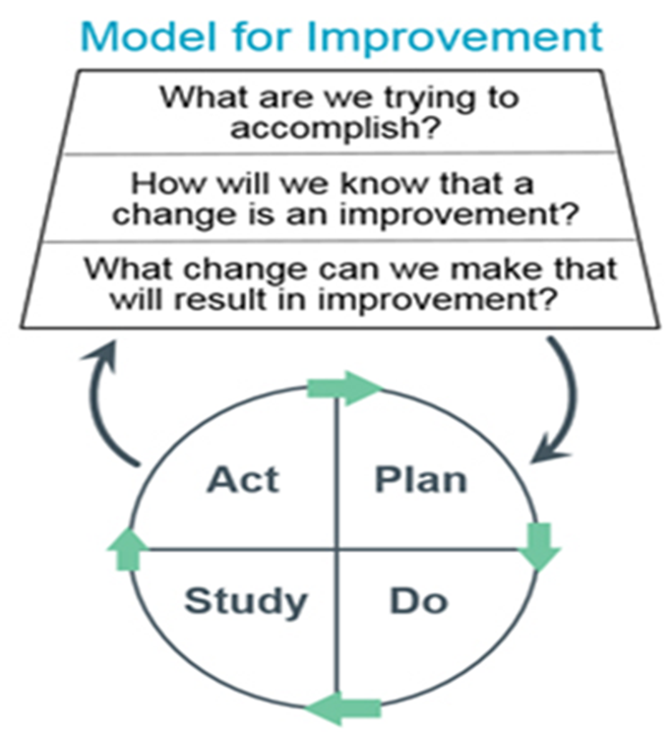
Understanding the Role of the Professional Nurse Advocate
Proposing a Networked Approach to Implementation
Dr Michele Platt, Manager, East Midlands Spinal Network Email: michele.platt@emas.nhs.uk
Background
Restorative Supervision
EMCCN Gap Analysis
The Professional Nurse Advocate (PNA) role was developed in the Midwifery field with PMAs. Historically, the UKCC introduced Clinical Supervision in 1996 with a Position Statement¹, but with no mandatory requirement for RNs to either deliver or receive it. Stress, mental health issues and burnout amongst healthcare professionals increased during the Global Pandemic in 2020 resulting in demand for supportive measures towards people’s restoration and recovery.
Restorative supervision is a key element of the Model. It is carried out within a supervisor/supervisee relationship with a skilled facilitator, either 1:1 or group setting. The aim is to be reflective with a clinical focus, cognisant of the work and systemic context. It addresses emotional needs of staff, restores thinking capacity and provides people with the opportunity to process their thoughts and contemplate different perspectives, all of which may be key in the post traumatic environment of the pandemic world.
Aims
Benefits of the PNA Role⁴
Stakeholder Involvement
To provide a clear understanding of the role of the PNA for nurses and managers
To explore how this might be rolled out equitably across ICUs in the East Midlands region
To garner the support of a Network approach where member organisations collaborate and cooperate to develop processes that support equitable access for our patients to standardised, high quality care.
Facilitates professional resilience
Supports provision of high quality care
Identifies areas for improvement
Develops the advocacy role of nurses
Underpins strategies to develop and invest in nurses
Provides flexibility for local implementation
Supports revalidation
Improves sickness and absence rates
Improve individual well being
Decreases stress and reduce burnout
Increases enjoyment in work and job satisfaction
Increases retention and staff feel valued
Improves working relationships and team dynamics
Enhances management of work life balance
Leadership is a key component of the PNA role and responsibility weighs heavy therefore to ensure that processes are in place to support equitable implementation. The Network is ideally placed for regional collaboration to provide assurance to commissioners that appropriate steps have been taken for equitable access and delivery
xxxxx
Defining the Role
Analysis
A PNA is a qualified practising nurse, defined by the mode of practice which deploys the A-EQUIP model
Consider different methods of delivery to be agreed i.e. group or individual supervision
Time to be allocated for PNAs to function
Time to be agreed for staff to be released to attend supervision sessions
Agree ratio of PNAs to nurses and baseline frequency of supervision
Review and agree the number of PNAs required to implement the A-EQUIP model in each unit based on these equitable arrangements
Obtain sign-up at the EMCCN Board to a PNA Service Development Programme for implementation in all member organisations to ensure equity of access
A-EQUIP Model
PNA Education & Training
The Advocating for Education and Quality Improvement (A-EQUIP) Model facilitates PNAs to support the nursing workforce to lead and deliver quality improvement initiatives, through restorative supervision, in response to service demands and changing patient requirements. Developed from Proctor’s (1986)² formative, normative and restorative functions the model has been robustly tested in Midwifery³.
University delivered 10 week module at Masters Level – For PNA development to facilitate restorative supervision with their colleagues and teams.
Funded by NHSE / HEE. Supported by Ruth May⁵ where she has promised two PNAs in every critical care unit in England; equity issues aside.
Restorative Clinical Supervision
Education and Development
Personal action for quality improvement
The Network Approach & Model for Improvement ⁶
What are we trying to accomplish?
To provide psychological, professional and educational support to critical care nurses across the region following a period of prolonged trauma, resulting from a global pandemic
How will we know that the change is an improvement
Recruitment and retention improvements
Self-reported staff wellbeing and job satisfaction
Reduced incidents
Reduced sickness and absence
Continued service improvement
What change can we make that will result in an improvement?
For all critical care nurses across the East Midlands region to have access to restorative supervision via a trained PNA
Recommendations
*Treat this presentation as a call to arms
*Challenge key stakeholders on behalf of the Network including NHSE, HEE and Ruth May
*Links to CC3N for agreement and a way forward to generate equity of access across England
*EMCCN Lead Nurses to identify local organisation plans for implementation, where in place to be shared with the Network
*EMCCN Restorative Supervision Strategy for Nurses to be written collaboratively, clearly stating the standards required
*Baseline data collection to assist future planning i.e. number of nurses and number of PNAs in training / qualified in practice
*Add the PNA objectives and wellbeing standards to the EMCCN Self-Assessment Tool
*Discuss PNA service development with commissioners regarding way forward
REFERENCES: 1. UKCC (1986) A Position statement on Clinical Supervision for Nurses and Health Visitors; 2. Proctor B (1986) Supervision: a co-operative exercise in accountability In Marken M and Paynes M (Eds) Enabling and Ensuring: Supervision in Practice. National Youth Bureau and the Council for Education and Training in Youth and Community work; Leicester 3. https://www.england.nhs.uk/mat-transformation/implementing-better-births/a-equip/a-equip-midwifery-supervision-model/ 4. Petit and Stephen, (2015) Supporting Health Visitors and Fostering Resilience, Institute of Health Visiting, England; 5https://www.nursingtimes.net/opinion/i-am-pleased-to-announce-the-roll-out-of-the-professional-nurse-advocate-programme-05-03-2021/ 6. https://www.england.nhs.uk/improvement-hub/wp-content/uploads/sites/44/2011/06/service_improvement_guide_2014.pdf

