Slide 1
Digitalisation of Step 1 Adult Critical Care competencies
CC3N symposium, 15 July 2022

Slide 2
Who are we?
Content owners
Critical Care Networks National Nurse Leads ​(CC3N)
Platform owner
Health Education England Technology Enhanced Learning (HEE TEL)
Co-design & delivery support
NHS Elect

Slide 3
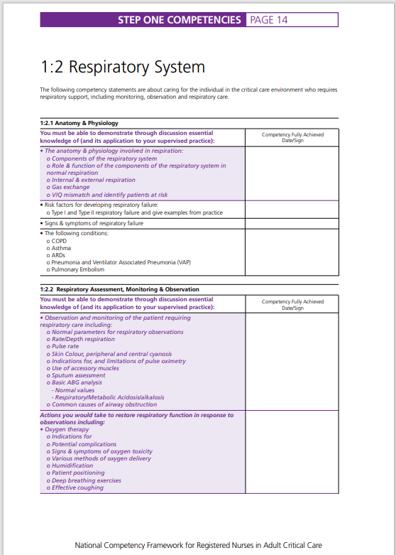
What are we digitalising?
PDF document
700 competencies
For all qualified new CC nurses
Completed over 6–12 months
Used nationally

Slide 4
Why are we digitalising the Step 1 competencies?
There is the need and opportunity to:
Grow and transform our workforce using emerging technology
Improve the digital literacy of our staff
Use digital technology to improve patient care and release more time for care
Notes:
https://www.longtermplan.nhs.uk/wp-content/uploads/2019/05/Interim-NHS-People-Plan_June2019.pdf
Blended learning
Digital – check re: opportunities

Slide 5
Opportunities of digitalisation
Quality assurance
Improved standardisation & control of use
Patient safety
Ability to update content more easily
Workforce planning
National visibility of staffs’ skills data
‘Digital first’ workforce
Opportunity to improve digital literacy
Staff mobility
More efficient transfer of staffs’ skills data
Resource requirements
Reduced wastage of staff time & paper
Visibility across competency frameworks
Opportunity to more easily see skills required for different roles, across care settings and professions

Slide 6
Programme approach
Establish need
Edit content & develop digital platform
Testing
National pilot
Sep ’21 – July ‘22

Slide 12
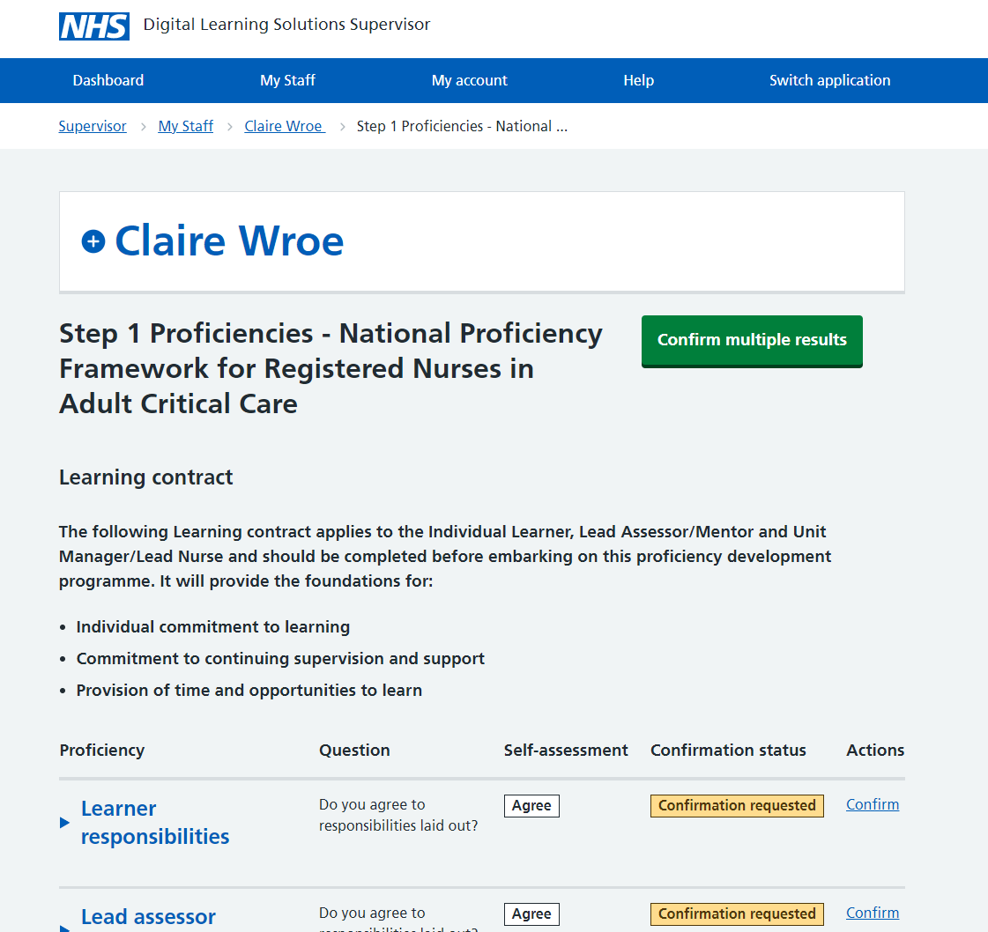

Slide 13
Platform roles & key responsibilities
Role hierarchy
Key responsibilities
Clinical Centre Manager
Trust-level lead & oversight
Select who are Educator/Managers & Administrators
Administrator
Approve self-registration of profiles on platform
Raise support queries or issues
Educator / Manager
Enrol Learner on Step 1 Framework & perform final sign-off
Select who are Assessors
Assessor
Confirm Learners’ self-assessment of individual proficiencies
Learner
Complete self-assessment of proficiencies
Request Assessor confirmation of proficiencies
Note: There can be multiple people in each platform role

Slide 14
National pilot approach
Pilot will run mid-Aug '22 to Mar '23
Up to 60 NHS Trusts over three cohorts (20 Trusts per cohort)
EOI open 4 – 22 July, 5PM
Jul | Aug | Sept | Oct | Nov | Dec | Jan | Feb | Mar
Expression of interest
EOI
(3 weeks)
Selection
(3 weeks)
Cohort 1
Setup (8-10 weeks)
Start using
Cohort 2
Setup (8-10 weeks)
Start using
Cohort 3
Setup (8-10 weeks)

Slide 15
learningnetworks@nhselect.org.uk

