Slide 1
Adult Critical Care Planning Programme
Anna Vogiatzis
Adult Critical Care Programme Manager
July 2022

Slide 2

Our ambitions for Adult Critical Care
The model needs to achieve the following:
Level up the number of beds per capita accounting for:
Deprivation
Geography
Specialised vs non-specialised services
Elective vs emergency work
Improved staff retention and working conditions :
Support career development for non-medical staff
Evaluate different workforce models – professional body engagement required
Implement novel clinical models: enhanced care, telemedicine – professional bodies already supportive
Equitable
Timely
Effective
Efficient
Safe
Patient centred
Reduce:
Surgical cancellations associated with critical care capacity
Delayed emergency admission rate
Delayed discharges
Extended lengths of stay
Right patient, right place, right time:
Understand baseline gap in capacity: local, ICS, national
Develop the right balance of L1, 2, 3 capacity
Ensure payment model supports innovation and flexibility
Improve clinical outcomes:
Rehabilitation & follow-up services
Bolster support services where required e.g. transfer, outreach
Build on COVID experience in clinical trials and audit/QI

Slide 3








The ACC Programme will work in collaboration with regions, systems, ODNs and providers to deliver a transformational framework for the future sustainability of Adult Critical Care.
Expansion of Critical care provision to ensure equitable resource to meet population needs reflecting differences in health inequalities in regions. In line with the elective recovery programme and Long Term Plan support systems to prioritise and secure funding from system allocations for the recurrent impact of the necessary expansion of critical care services across the country.
Introduction of a further 300 ACC beds, 900 Enhanced Care beds and 200 rehab/weaning beds to aim to achieve 10 beds per 100k per head of adult population.
Planning: Expansion of Critical Care and Enhanced Perioperative Care and pathway management
Establish commissioned networks of providers to deliver services across a system or ODN
Larger providers (hubs) support a network of ACC units to deliver their service to their population.
The leadership role played by the hubs and ODNs throughout the pandemic has been invaluable in delivering care across their Networks as well as supporting staff in their training and education and resilience.
Develop a new payment framework for ACC
Commissioning based on a networked footprint with one responsible commissioner from an ICS/ICB on behalf of other commissioners.
Develop, test and implement a payment model that incorporates different models of critical care services, is responsive to geographical differences and including (but not limited to) ACC, transfer, enhanced care, outreach, surge in the model for payment. Describe and test the revised blended payment approach with ICBs and provider collaboratives.
Workforce redesign. Develop New Models for WORKFORCE planning and wellbeing
Development of new models for workforce solutions which will support regions in developing plans to meet short-term (2021-23) and longer-term (up to 10 years) critical care workforce demand.
Currently 1200 nurse vacancies against funded establishments with a risk of further workforce loss. This gap does not include the increase in staff numbers required to deliver the new model.
The programme will work with professional bodies and HEE to implement training programmes and offer sustainable career development opportunities to improve staff retention.
Transfer: continued monitoring and development of dedicated ACC transfer services
Continue monitoring of the implementation of the funded transfer services and published Transfer Service Specification to allow ICS/regionally driven transfer and ACC capacity mutual aid if needed.
Develop improved systems to monitor supply / demand and outcomes
Measuring impact of change on clinical outcomes and service efficiency.
Develop metrics and key performance indicators to monitor implementation of expansion of Critical Care and Enhanced Perioperative Care provision.​.
Dashboard utilisation and further development and review clinical database.
Model need by region, system and network to support regional/system colleagues to expand capacity, access and improve outcomes. Develop and share needs assessment.

Slide 4




We have developed a combined Adult Critical Care and Enhanced Perioperative Care model to maximise productivity and resilience.
New models of care: Enhanced Perioperative Care
An intermediate level of care between that provided within High Dependency Units and a general ward, where enhanced advice and support from the Critical Care team can be accessed, partly to meet perioperative demand, support recovery and protect elective capacity during emergency surge.
Increased LEVEL 2 and 3 capacity
ACC is under resourced, we will expand capacity and create a sustainable number of baseline beds that are available for emergency and urgent admissions.
Establish sufficient elective capacity. This should be informed by the impact of winter or major incidents on elective cancellations due to lack of availability of an intensive care bed.
Improved pathway management, including long-term weaning and rehab care
Access for patients to appropriately resourced rehabilitation and tracheostomy weaning beds that allow for appropriate support, improve patient outcomes and reduce delayed discharge.
High quality ACC transfer services
Provide a resource to regions to enable the development of critical care transfer services that deliver a responsive, high quality, safe, efficient and sustainable service that can provide both escalation of care and pathway management across providers and regional footprints

Slide 5

Benefits of the enhanced and critical care model
Bed occupancy on average increases from 80% during the summer to 83% during winter (Oct -March). Ideally this should be 75% to optimise flow and reduce nosocomial infection. Occupancy is currently (June 2022) running at 85% this is much higher than is the norm for this time of year.
Of the 1.4million operations done per year which might be classified as 'major inpatient surgery', around 25% will have a predicted mortality >=1%, it is this group of 350,000 patients per year that should have access to an enhanced perioperative care bed (level 1), however currently only 100,000 are accessing this care.
Average number of non-urgent operations cancelled increases by 10% between the summer and winter months: again an under-estimate of demand (e.g. mass cancellation of elective activity in 17/18 and 18/19 winters)
Currently, some of these post-operative patients are admitted to a L2 critical care post-surgery with an average length of stay of 3 – 4 days using approximately 400,000 bed days per year. It is anticipated that by developing enhanced care beds in an appropriate setting this will reduce the average length of stay to 1 – 1.5 days reducing the overall bed days to approximately 150,000 per year.
10% delays to discharge and rehabilitation after critical illness causes bed blocks closures and unavailability.
Over 3 years, the new model for enhanced and critical care seeks to build in resilience to services so that elective care is more protected when emergency demand for critical care activity increases, and that there is more equitable access to critical care across the country, by:
  Increasing the number of enhanced perioperative care beds (level 1) available by circa 900 so that there is capacity for the 350,000 patients (spells) who need that level of care.
  In doing so it will freeing up approximately 300 critical care beds (level 2 and 3) currently used by the 100,000 high risk surgical patients who are accessing critical care beds and can now be treated in enhanced care beds.
  Increasing in the number of critical care beds (Level 3 equivalent) by 300 to enable those areas that are currently under-resourced, to level up care and offer a more equitable access for patients.
  Creating 200 staffed weaning/rehab beds to optimise rehabilitation, reduce delayed discharges, will ensure long term patients are supported appropriately.
Mutual aid, case mix support and transfer of patients where appropriate through a network of providers supported by Operational Delivery Networks and 24/7 transfer services will improve productivity and throughput, ensuring additional resilience and equitable access

Slide 6
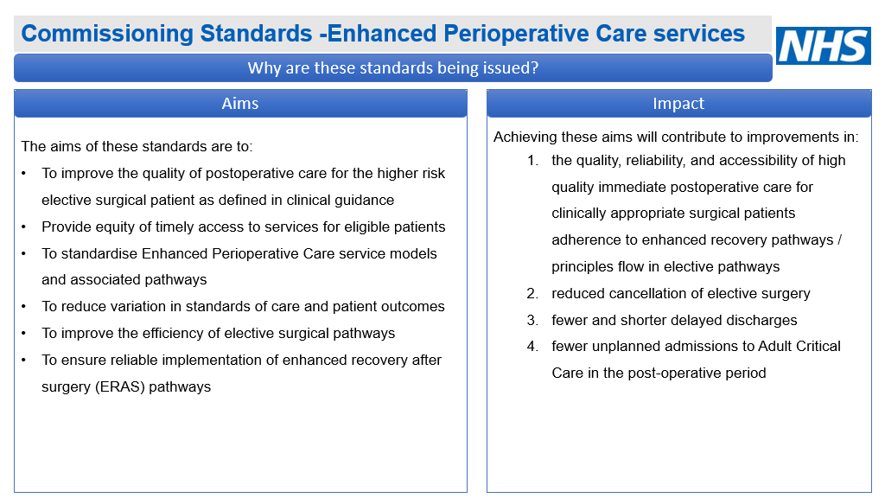

Slide 7
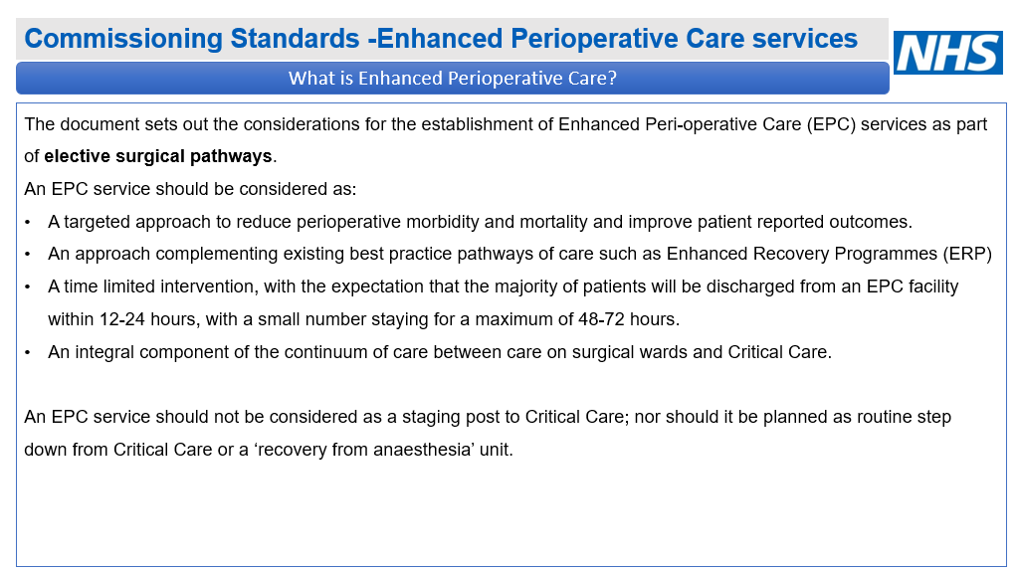

Slide 8
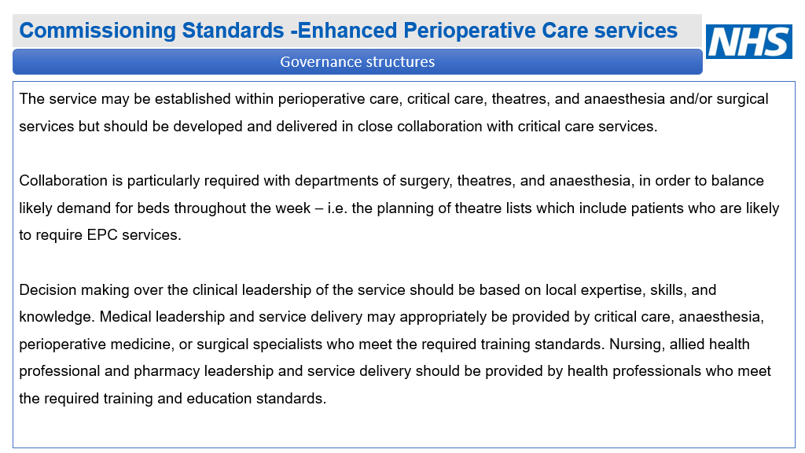

Slide 9
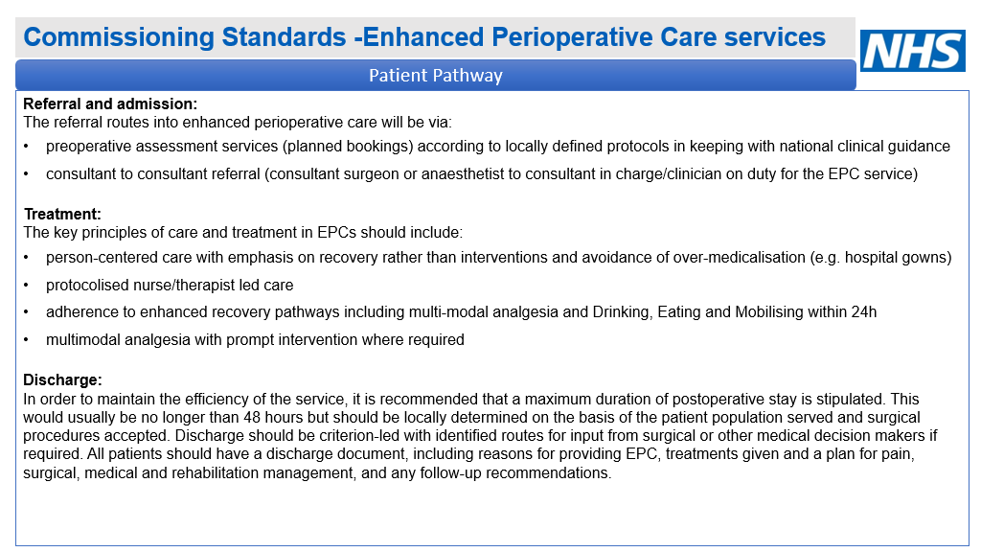

Slide 10
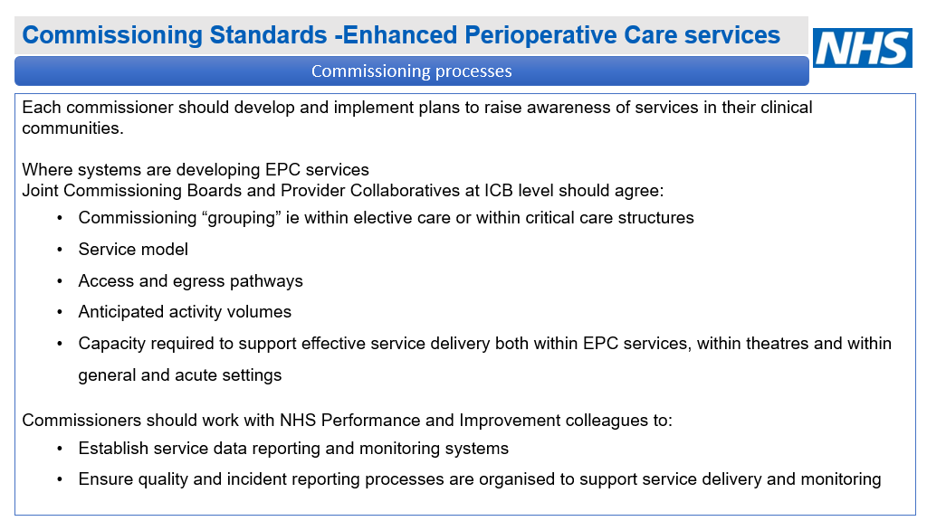

Slide 11
Links and tools
Colleagues can access the following documents and reports in the ACC FutureNHS collaboration pages :
Adult Critical Care Capacity COVID19 - FutureNHS Collaboration Platform
  Stocktake reports for medical workforce and estates 2021
  Flows mapping
  Transfer DOS daily report
  ECMO DOS daily report
  Standards and specifications
  Toolkits Transfer toolkit already published
  Coming soon: Enhanced perioperative care, workforce strategy, “022 ACC stocktake
DOS dashboard and Stocktake 1 can be found on OKTA:
ACC Dashboard: Main Dashboard - Tableau Server (england.nhs.uk)
ACC Stocktake 1 Report: Views - Tableau Server (england.nhs.uk)
For access and permissions for any of these reports email: england.acc-programme@nhs.net

Slide 12



Critical Care
Standard Qualified in Specialty (QIS) Programme
James McLean Deputy Chief Nurse HEE
Visiting Professor Birmingham City University

Slide 13
Critical Care
COVID-19 added significant complications into the Critical Care arena. Throughout the early phases of the pandemic it was clear that there are insufficient skilled Critical Care staff (Nursing and AHP) to provide pandemic emergency cover in the scales that were modelled as well as the day-to-day requirements and safety of critical care patients across the NHS.
UKCCNA position statement
https://www.ficm.ac.uk/sites/default/files/ukccna_position_statement_critical_care_nursing_workforce_post_covid_05.05.2020.pdf

Slide 14
Workforce Issues Identified at the time of response
Whilst there is a general critical care nursing staff vacancy factor Circa 11.6% across England (some units report higher) and some areas such as the London region report an average of 13% overall.
This is mainly focussed in the band 5 and band 6 nursing staff. In addition to this, the2018 CC3N survey identified “18 critical care units reported an annual staff turnover in excess of 20% with some as high as 42%.” (CC3N Workforce Survey Report April 2018)
Noted ambitions to increase critical care workforce by as much as 25% would see an entire graduating year taken into Critical Care Posts

Slide 15
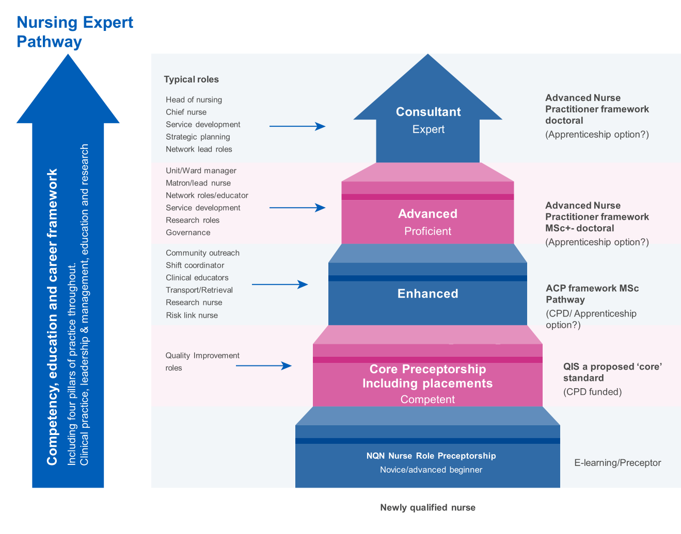
Nursing Workforce Career path Development

Slide 16
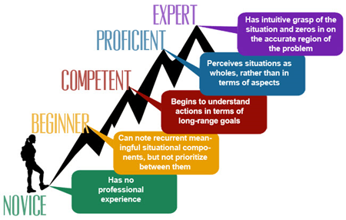
CC3N census up to 10K practitioners need access to QIS to meet GPICs Standards
MSc or Higher Level
QIS Aimed at this level of practitioner
http://xbrl.squarespace.com/journal/2019/8/6/from-novice-to-expert.html

Slide 17
Critical Care
HEE Secured £10M to support the procurement of a “Standardised” Qualified in specialty programme to enable up to 10,000 Junior adult Critical Care staff and appropriate AHP colleagues to access vital education to improve quality of care for patients and meet GPICs guidance for 50% of every shift to be appropriately QIS trained.
System leaders, Critical Care professional bodies and expert critical care nurses were brought together to discuss, design and agree the framework for the QIS programme. This was convened with 4 nations representatives involved.
A blended learning approach was agreed to enable flexibility to enable large volumes of staff to attend without adversely impacting service.

Slide 18
What did we do?
Contact with CC3N
ODN’s
Professional Bodies
NHSE/I colleagues
Four Nation Colleagues
Weekly Round table discussions to formulate, agree and develop a Nationally recognised and Standard programme
2 working groups
Educational framework
Workforce Transformation

Slide 19
Critical Care
The Health System unanimously identified that there is a requirement for a nationally recognised critical care qualification which is transferable across the country, equitable across institutions in terms of hours of practice and academic credits and consists of both an academic and practice component leading to an accredited award.

Slide 20
Other Support as an Outcome of the Pandemic
All ITUs across England are reported to have a minimum of 2 Professional Nurse Advocates (PNA) trained to support mental health and wellbeing but struggling to be released to perform supervisory activities.
CC3N have released competencies for Nursing Associates within adult critical care and is well received.
Critical care learning materials on-line resources for all levels of staff and professions remain available and regularly reviewed and updated.
AHP professionals (Physio, ODP, SALT, OT and Paramedic) can access elements to support critical care

Slide 21
What next
The recognised Critical Care Professional groups were consulted (UKACCN, BACCN, CC3N and the RCN) with and agree with this proposal and also supported by England’s Chief Nursing Officer.
ODN’s need to work with systems to fill the places across the regions
More investment is being planned and there will be opportunity to add educational providers

Slide 22
Thanks to Julie Platten and CC3N
Chris Hill Janice Sigsworth
Andrea Berry Jaqueline McKenna
Emma Wadey Ramani Moonesinghe
Clare Leon-Villapalos Fiona Wyton
Henrietta Bankas Siobhan Heafield
Marie Moore Ifor Evans
Kerri Eilertsen-Feeney Graham Brant
Jonathan Elias Julie Coombes
Karen Wilson Christian Brailsford
Karla Hobbs Paul Reeves
Jack Parryjones
Stephanie Smith
Parkin Emma
Laha Shondipon
Mark Fores

Slide 23

What are the current staffing challenges that face critical care workforce? Evidence and Practice, and SEISMIC
Professor Natalie Pattison
Professor of Clinical Nursing, University of Hertfordshire/ East & North Herts NHS Trust;
Chair NOrF; Chair UK Critical Care Nursing Alliance; Deputy Chair NIHR National Specialty Gp Critical Care

Slide 24

Safe Staffing in the ICU - what do we know?
Mortality proportionately increases with a reduction in nurses on the ward/unit
Significant associations between lower levels of critical care nurse staffing and increased odds of both patient mortality (1.24–3.50 times greater) and nosocomial infection (3.28–3.60 times greater), increased hospital costs, lower nurse-perceived quality of care and lower family satisfaction
(Rae et al 2021, Inten Crit Care Nurs, Dec;67:103110.)

Slide 25
How is staffing measured?
Approach | Tools/authors
Nurse per occupied bed (proxy for nurse/patient ratio) | Nurses per bed (Davis et al 2014)
Timed/task activity approaches | Alexa Caseload Tool for Clinical Nurse Specialists (National Quality Board 2003) GRASP (Meyer 1987; Anderson 1997; Trundle et al. 2001, Hadley et al. 2004) RAFAELA System (Fagerström and Rauhala 2007; Fagerström 2014).
Regression based approaches (modelling) | Hourly bed census (Kortbeek et al 2014;2015)
Professional judgement | MEDICUS (combines acuity and prof judgment)
Acuity-quality method (acuity tools etc) | Safer Nursing Care Tool (Shelford Group) Birthrate Plus® in Maternity Settings (National Quality Board 2003) GOSHman Paediatric Acuity and Nurse Dependency Assessment Tool (PANDA) (Ellis & Chapman 2006) Jones Dependency Tool (JDT) in Emergency Nursing (Crouch & Williams 2006) Cassandra Tool (Jackson 2016) Community The Brighton Method (Ball 2010) Community
(Hurst K (2002) Selecting and applying methods for estimating the size and mix of nursing teams, London: DH.; Hayes and Ball 2012, https://qa.rcn.org.uk/-/media/royal-college-of-nursing/documents/publications/2012/march/pub-004234.pdf?la=en; RCN 2017 https://www.rcn.org.uk/professional-development/publications/pub-006415; The Health Foundation 2017, https://www.health.org.uk/sites/default/files/Workforce%20pressure%20points%202017_nurse%20supplement%20FINAL_0.pdf) .

Slide 26
In ICU – what tools/methods are used?
Approach | Tools/authors
Nurse per occupied bed (proxy for nurse/patient ratio) | Nurses per bed
Timed/task activity approaches and Professional judgement | Dependence Nursing Scale (DNS) (Clini et al., 1999) Nursing Interventions Classification NIC (Butcher et al., 2013) Nursing Activities Score (NAS) (Miranda et al., 2003) NEMS Nine Equivalents of nursing Manpower Use (Reis-Miranda et al., 1998) American Association of Critical Care Nurses Synergy Model for Patient Care (ACCN, 2014) SIPI (Sistema Informativo della Performance Infermieristica) (Moiset et al., 2003) MEDICUS (combines acuity and prof judgment) CAMEO II (Paediatrics) Connor et al 2019)
Acuity-quality method (acuity tools etc) | Patient illness focused scores – also used for workload calculations (APACHE [I/II]/TISS/SOFA/SAPS II)
(Greaves et al, 2018 Int Crit Care Nurs 48: 10-20;
Connor et al, 2019 Dimensions of Crit Care Nurs, 38 (3): 146-152)

Slide 27
Staffing models in ICU – key factors
Numbers of registered nurses, with critical care qualification, and skill mix variation undefined
Inconsistency in staffing measurement
There are no intervention studies to guide deployment of staffing in critical care, and no evidence to support one staffing model over another
Patient ratios
Environment
Workforce availability
Skill mix

Slide 28

ICU staffing models
Image: bbc.com

Slide 29

Pre-COVID-19 pandemic and surge changes
1:1 for level 3 patients (patients with the highest acuity, except ECMO);
1:2 for level 2 patients (patients with single organ failure)
ICU
ICU
ICU

Slide 30
SCCN, 2020; https://www.med.upenn.edu/uphscovid19education

Slide 31
What are the consequences of working in such different models?

Slide 32
ICU Burnout
Prevalence for high emotional exhaustion was 31% (95% CI, 8-59%)
for high depersonalization was 18% (95% CI, 8-30%)
for low personal accomplishment was 46% (95% CI, 20-74%)
Emotional exhaustion had a significant relationship with depression and personality factors. Both sociodemographic factors (being younger, single marital status, and having less professional experience in ICU) and working conditions (workload and working longer hours) influence the risk of burnout syndrome.
Ramirez-Elvira 2021, Int. J. Environ. Res. Public Health, 18, 11432
Pattison et al 2020, Nurs Crit Care. 2020;25:93–101.

Slide 33
COVID burnout in ICU nurses
Pre-COVID overall 16-33% in nurses
CC3N data – Intention to leave
CANDID+ data – similar
1 in 3 couldn’t access therapy
US survey: Symptoms of moderate to severe depression and anxiety were reported by 44.6% and 31.1% of respondents, respectively.
47% were at risk for having PTSD.
Guttormson et al 2022 Heart & Lung,
55: 127-133,

Slide 34
Consequences for nurses: Burnout – international comparison
Dall'Ora et al. BMJ Open 2015;5:e008331.

Slide 35
RN4CAST: Largest international study
33 659 nurses and 11 318 patients in Europe; 27 509 nurses and more than 120 000 patients in the US; 15 countries
Nurse outcomes (hospital staffing, work environments, burnout, dissatisfaction, intention to leave job in the next year, patient safety, quality of care),
Patient outcomes (satisfaction overall and with nursing care, willingness to recommend hospitals).
Higher mortality associated with more occupied beds per RN (RR 1.22, 95% CI 1.04 to 1.43, p=0.02) (Griffiths et al 2016)

Slide 36
What is a critical care nurse?
‘a registered nurse who has the right knowledge, skills, and competencies to meet the needs of a critically ill patient without direct supervision. The knowledge, skills and competencies they require to nurse critically ill patients should reflect the level of patient need, rather than being determined by the patient care environment (e.g, HDU or ICU) (RCN, 2003)’
ICU
(Royal College of Nursing, 2003, Guidance for nurse staffing in critical care 2003, RCN: London)

Slide 37
What are the key premises of adequate ICU nurse staffing?
Not simply numbers
Skill mix
ICU and other qualification
Shift patterns
Nurse outcomes
Education/retention
MDT skill mix
Unit size
Environment
Establishment calculations

Slide 38
SEISMIC – Study to Evaluate the Introduction of nurse Staffing Models in Intensive Care
COV
I
D
i) Which outcomes are important to stakeholders able to be measured?
  iii. What impact COVID has had on ICU nurse staffing models?
Systematic Review (n=55 papers)
Outcomes associated with ICU nurse staffing
Staffing measures
Focus Groups (n=52 in 7 FGs)
Patients and family members
Nurses, physios, doctors
Interviews (n=14)
Commissioners
Network Directors and Lead Nurses
  ii. What difference nurse staffing makes in ICU and what factors influence?

Slide 39
SEISMIC Systematic review – key findings
55 studies in total reviewed
41 cross-sectional (including retrospective and prospective aspects) and 14 longitudinal studies (8 retrospective and 6 prospective).
Patients included per study varied between 30 and 159,400.
41 studies measured patient outcomes: mainly mortality and nosocomial infection.
13 studies measured care process outcomes, including costs.
4 studies measured family satisfaction, and 1 study measured nurse outcomes.
44 studies were designed with nurse staffing as a primary focus
23/55 (42%) had strong internal validity (+ +)
14 studies were longitudinal (25%), 6 of which had strong internal validity (43%).

Slide 40
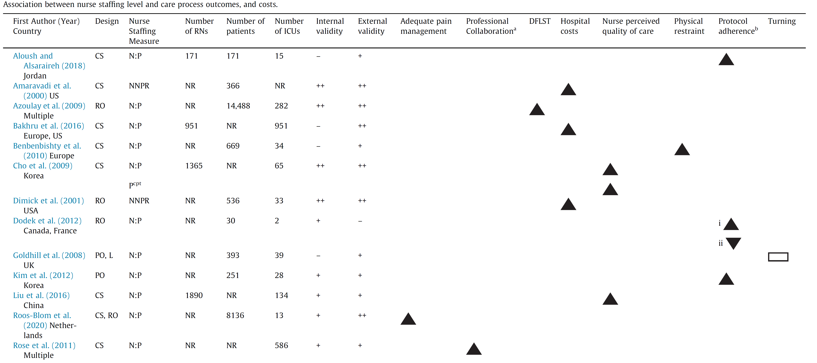
Staffing and care process outcomes

Slide 41
Family Satisfaction

Slide 42
Patient Outcomes sensitive to staffing (SEISMIC): SR, FGs, both
Mortality (ICU/ In-hospital)
Length of Stay (ICU/ Hospital/ Ventilator Days)
Complications of ICU stay
    VAP/Other infections (lines etc)
    Pressure injuries/acc. extubation
  Adverse events (medication)
  Additional from focus groups
  Appropriate sedation
  Missed care
  Prepared for ICU discharge
  Timely mobilisation
  Feeling safe
  Satisfaction
  Return to normal life
  Quality of life
  PTSD, anxiety, depression
  Personalised care
(Rae et al 2021, Inten Crit Care Nurs, Dec;67:103110; Endacott et al, 2022 Nursing Management)

Slide 43
Family Outcomes sensitive to staffing¹ (SEISMIC): SR, FGs, both
Family member satisfaction
Family needs met
Additional from focus groups
Long term coping, coping with bereavement
Able to ask questions
Communicated with
Satisfaction
Feeling safe
Preparedness for ICU and for ICU discharge
(Rae et al 2021, Inten Crit Care Nurs, Dec;67:103110; Endacott et al, 2022 Nursing Management)

Slide 44
Nurse outcomes sensitive to nurse staffing¹ (SEISMIC): (SR, FGs, both)
Additional from focus groups
Sense of belonging
Time to care and to plan ahead
Capacity to support others
Staff wellbeing
Moral distress
Burnout
Absence/sickness/turnover
Team working/communication
Burnout
Fatigue
Job satisfaction
(Rae et al 2021, Inten Crit Care Nurs, Dec;67:103110; Endacott et al, 2022 Nursing Management)

Slide 45

Critical care work during COVID-19: A sociological analysis of staff experiences
“Teamwork was one of the things where, actually, humanity, certainly in the hospital, really pulled together.” (Doctor)
“It was a really positive experience. I worked with some amazing staff who were incredible… I worked with people who have made me laugh, who gave such amazing care, who were so knowledgeable about their skill, their craft. Unbelievable. I was in such awe of these staff... and I can truthfully say I know I did the best I can. So, I’m very proud of myself.” (Redeployed ODP)
Axis of convergence: Teamwork
Unprecedented sense of teamwork and camaraderie
Sense of common purpose and professional pride
Influx of redeployed staff a source of moral & practical support
Improved clinical, operational and management skills
Increased resilience, confidence and self-esteem
Montgomery et al 2021 BMJ Open;11:e048124

Slide 46

Caring, Learning And Pandemic response during COVID-19: NHS Staff Experience of Working in Critical Care
Montgomery et al 2021 BMJ Open;11:e048124

Slide 47
Invisible work of critical care nurses
How nurses undertake ‘organising of work’, which is viewed as ‘dirty’ or ‘invisible’ work, as not involving direct patient care. It is about creating working knowledge, through information location, interpretation, sense-making and checking to translate into narratives for contributing to individuals care trajectories (Allen, 2015)
There is a need to balance technology and caring; coordinating these to achieve person-centred care (Pattison, 2021)
Allen, D., The invisible work of nursing. Hospitals, organisation and healthcare. 2015, London: Routledge;
Pattison 2021 Nurs in Crit Care 26: 421-4

Slide 48
Thought processes around ICU staffing
Higher “situational” awareness for some individuals increased their stress and anxiety. Finally, our results suggest that professionals have varying concepts of where their personal responsibility to minimize risk begins and ends (“risk horizons”) and that these horizons may affect their behaviour both in and beyond ICU
Patient care delivery may be
affected by professionals’ perfectionist or pragmatic approach. Perfectionists’ team role may be compromised and they may experience cognitive dissonance and subsequent isolation/stress.
Psychological safety in a team may be improved within the confines of a perceived “A” (optimal) team but diminished by interdisciplinary tensions.
D’Lima et al 2018, Crit Care Med 46:60–70)

Slide 49
Alternative propositions to deal with staffing crisis and under-recruitment
Nurse apprentices
Trainee nurse associates – levy issue
Nurse First
‘Two-tier’ nursing
Longitudinal data needed of effect of these initiatives
Degree-nursing and link with mortality

Slide 50
Link between morale and staffing
Hospitals with good work environments and better professional nurse staffing have more satisfied patients and nurses, and evidence of better quality and safety of care (Aiken et al 2012); this is true of ICU as well (Bae et al 2021)
“Improving hospital work environments could be an affordable organisational strategy to improve patient outcomes and retain qualified nurses providing care directly”
(Aiken et al 2012, BMJ 2012;344:e1717)

Slide 51
ICU nurse outcomes and staffing
Bae et al (2021)’s review - six studies found the positive relationships between nurse staffing and adverse nurse outcomes.
Nurse to patient ratio was positively related to burnout, stress, and fatigue.
BUT Job dissatisfaction and plan to leave were not related to the nurse to patient ratio, nor were Nurse hours per patient day or perceptions of adequate nurse staffing associated with intent to leave.
Perception of adequate nurse staffing was negatively related to stress and job dissatisfaction, high burnout, intention to leave, and back pain
(Bae et al 2021, Nurs Crit Care, 1–10 doi: 10.1111/nicc.12588)

Slide 52
What will help?
Big data needed – mustn’t shy away from this and need to build it in at a systems level
Using EPR patient data and linking to patient outcomes*
Teams and Nurse characteristics
Look at intention to leave, turnover, agency use, experience of work, work environments at all levels (unit/hospital), culture
Effects of nurse staffing and costs of care
Develop real-time quality metrics and outcome that link nursing workload, nurse-sensitive outcomes and that capture the ability to meet patient care needs
Evidence: prospective, experimental designs, time-series analysis, process-based designs.

Slide 53

Practical approaches
Sharing the workload;
Supporting colleagues;
Buddy wards systems and networks;
Skills and competence appraisal;
Education opportunities;
Career frameworks
“Wellbeing”

Slide 54
Nursing leadership
Positive leadership behaviours, styles or practices and increased patient satisfaction and reduced adverse events (Cummings and Wong, 2007)
Transformational
Supportive
Empowering
Emotionally intelligent
Resonant (joint sense of purpose)
Relationship-orientated
Compassionate
Shared/Collective
(Cummings and Wong, 2007 J Nursing Management, 15, 508-521)

Slide 55
Conclusion
Complex evidence base
1
Our responsibility
2
Evidence of reduction on mortality and morbidity with increased ICU staffing ratios
3
Positive leadership and work environment critical for nurse and patient outcomes
4

Slide 56
Articulating our value
Thank you
n.pattison@herts.ac.uk @drnatpat
At patient level
Interdisciplinary level
At unit level and board level
More broadly in society

Slide 57

Introducing the Nursing Associate Programme In
Critical Care
Fiona Wyton
(UHB Director of Nursing for Critical Care Services)

Slide 58

Why/Why not?
WHY - Our aim was to create a new career pathway for our HCSW’s and also to develop a pathway for our local population to enter nursing through widening participation and entry without experience.
Why Not? – Wouldn’t work in specialist area such as ITU. Can’t use existing RN budget and vacancies. Can’t support the additional educational burden on already fatigued mentors and assessors.

Slide 59

Workforce Constraints
88 Level 3 beds across 3 Hospital Sites – 480 RN’s, 53 HCSW’s
Unavailability Pre-COVID: 25-30%
Retention being the biggest risk to the service
RN Pipelines not sufficient to bridge the RN gaps
Retirements peaking

Slide 60

5 HCSW’s from Critical Care Services commenced their TNA training
Then – Cohort 1- 2017/19
Now – 2022/24 - Cohort 13
13 ITU RNA’s
51 ITU TNA’s (funded 58 wte)
Trajectory -64 RNA’s by 2024

Slide 61

Critical Care Cohort 1 – 2017-2019

Slide 62

UHB Cohort 1 (2017/19)

Slide 63
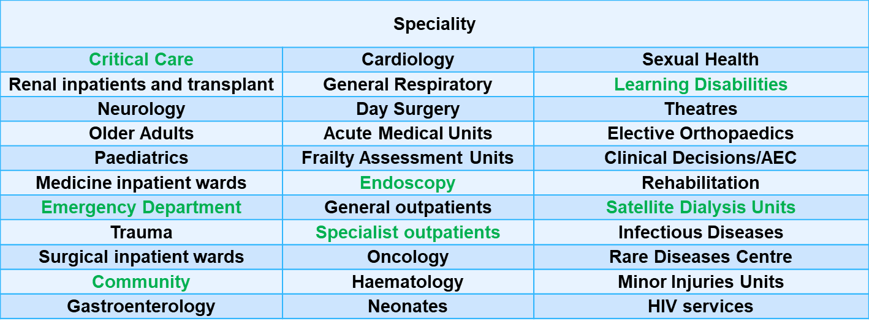
Trainee deployment (we never say no)

Slide 64
Nursing Attrition Rates
Around 12,500 nurses in adult social care in England left their jobs in 2019-20, representing a turnover rate of 41.3%
Student Nurse attrition rates in England at 25%
UHB TNA attrition rates at 14%

Slide 65

Workforce
National Trajectory for TNA/RNA Roles
Mar-22 | Nurse Associate | Trainee Nurse Associate | Grand Total
UNIVERSITY HOSPITALS BIRMINGHAM NHS FOUNDATION TRUST | 102.71 | 288.63 | 391.34
MANCHESTER UNIVERSITY NHS FOUNDATION TRUST | 154.53 | 181.44 | 335.97
NORTHERN CARE ALLIANCE NHS FOUNDATION TRUST | 98.63 | 110.6 | 209.23
LEEDS TEACHING HOSPITALS NHS TRUST | 54.57 | 149.92 | 204.49

Slide 66
Gaining trust and recognition
Started small
Dedicated TNA Clinical Education Team
“try one, buy one” approach
Didn’t dictate centrally but encouraged growth

Slide 67
Professional
Barriers
Perceived ‘threat’
RNA’s do not fit into specialist clinical areas
Financial expense
Similar to enrolled nurses – nothing new
Lack of understanding of their purpose “cheap nurses”
NMC recognition and registration cause for concern
Nobody had done it before – It was just another pilot

Slide 68

TNA UHB Clinical Education Structure
TNA
Education
1:18 ratio
Lead Nurse
Band 8a
0.8wte
Team Leader
Band 7
2.0wte
TNA Clinical Educators
Band 6
5.0wte
TNA Clinical Educators
Band 5 (RNA)
2.0WTE
TNA Clinical Educators
Band 4
2.0WTE
Admin
Band 3
1.2wte

Slide 69
Maintaining excellence
QIA for RNA’s in practice within registered workforce numbers
Safer staffing allocation when acuity peaks within units
Continuous supervision and understanding of skills mix requirements
Constantly re-evaluating RNA’s roles and responsibilities in practice
in conjunction with NMC registration

Slide 70
Learning
NA program established - focus on CPD opportunities and progressions
Smashing through the glass ceiling – ‘earn and learn’, new to care program
Post registration education and training – accessing specialist courses
Recognising CPD achievements – Assistant Lecturers B5, Clinical Educators B5
HEI’s recognising NA experience - coping well academically with RN top up
3x ITU RNA’s on RN top up program

Slide 71



Wellbeing
ITU Whatsapp TNA/NA professional chat, point of
contact, professional platform for exams, learning
and training advice
20 PNA’s in ITU to clinically supervise TNA’s/RNA’s,
provide restorative practice and confidential advice
Celebrate success, achievements, stay connected,
advertise conferences, training and development
opportunities

Slide 72

Neelam - Critical Care & UHB
2020 – COVID. Stepped up significantly in her clinical role
Trained reservists
Supported colleagues caring for critically ill patients.
Achieved TNA Certificate of Excellence
2021
Nurse critically ill patients
Won a ‘frontline worker of the year award’
Represented the Trust, Critical Care & NA’s on a BBC Documentary
Present to TNA’s about qualifying
Represent UHB at events
Achieved NVQ 2 + 3
despite dyscalculia
2013 – Started as a HCA in Critical Care
2018 - Joined the TNA programme.
Knew she wanted to progress within Critical Care & UHB
Dec 2020 – Became a Registered Nursing Associate in Critical Care
started Nursing her own level 2 & 3 patients
Supporting TNA’s on the unit
2022 -
Commenced
RN Top Up
at UOB

Slide 73

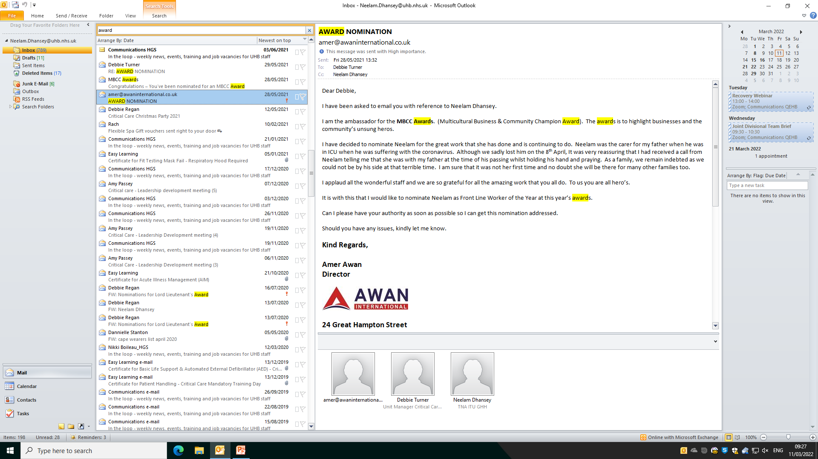



Slide 74


RNA’s in practice on ITU
Can be allocated to level 2 and 3 patients
Can support CVVH
Can do all medicine administrations including IV’s
Can administer all blood products
Can support Level 4 acuity
Can support side room allocations
Can undertake Step 1 competencies
Can undertake further critical care education and training opportunities
Can support safer staffing models
Can be allocated student TNA’s
Can’t work under PGD’s
Can’t be allocated students RN’s, assess and mentor
Can’t supervise registered practitioners

Slide 75
Objectives: A flexible, diverse, work force in critical care
Support the pipeline of staff into ITU
Skills that move with the patient
HCSW in ICU
Orientation & Induction
Functional skills
HCSW Core competencies
C3NN Specialist competencies
National standards
Mapped to FCC
Mapped to Steps competencies
Shared training programs
TNA/RNA/RN training pathway

Slide 76


