Slide 1
Professional Nurse Advocate (PNA): Introducing the PNA role Across England
Dr Emma Wadey, Deputy Director Mental Health Nursing
Friday 15 July 2022
#teamCNO
#PNA
#Professional Nurse Advocate
#PNAdvocates

Slide 2
COVID-19 Pandemic

Slide 3
What we knew…..
Emotional impact of Nursing
Nurse risk factors
Workforce gaps
Need for universal mental health and wellbeing support
Desire for accredited clinical and professional development

Slide 4
What Was Wanted
To be valued
To be invested in
Nurse led initiatives
Restorative clinical supervision
Leading recovery and transformation
Recognised and credible qualifications and continuous professional development

Slide 5
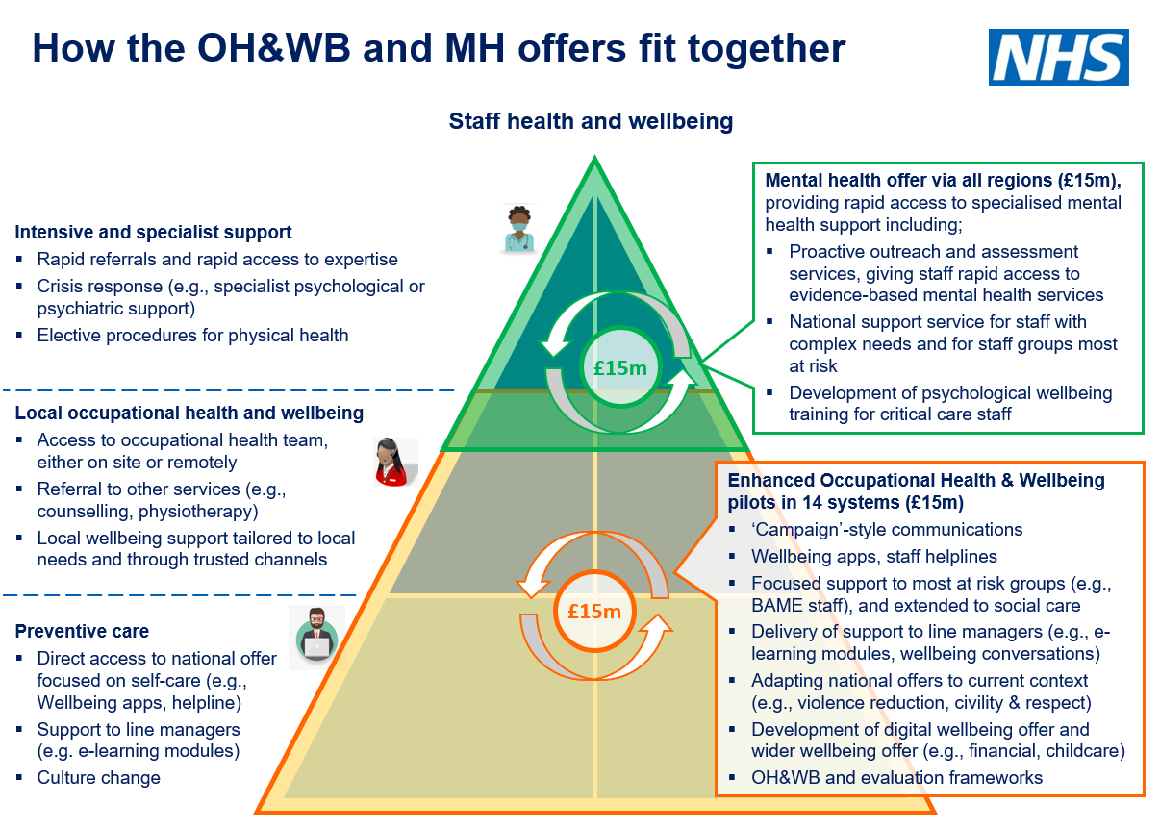
What we did: Integrated staff mental health support offer
3 key components to the work programme
Established 40 system-wide mental health and wellbeing hubs which provide proactive outreach and assessment services, ensuring staff receive rapid access to evidence based mental health services and psychosocial support where needed​
A national enhanced mental health service for staff with complex needs, delivered by NHS Practitioner Health ​
Providing 5000 training places in the Professional Nurse Advocate program for registered Nurses by April 2022 so they can provide restorative supervision for their teams
Progress to date in establishing MH&WB hubs
40 local areas have now established their mental health and wellbeing hub and are taking referrals.
NHSE/I website has a regional navigation panel to find out details of the staff mental health and wellbeing hub which covers either the area staff work in, the area staff live in or both.
The national NHSE/I team have put in place support for systems to mobilise hubs at pace:
Supporting the establishment of regional staff mental health support networks
National webinars on good practice and guidance
Future Collaboration site with FAQs, guidance and good practice examples
Offer of support including – buddying, expert clinician support, system deep dives.
We will be supporting hubs to undertake proactive outreach to ICU/critical care teams in their local area if that has not happened yet.
Enhanced mental health service
NHSE/I has also worked with NHS Practitioner Health to put in place an enhanced mental health service where hubs can refer the smaller percentage of staff that may have more complex needs (such as trauma or addictions).
This service can offer access to prescribing clinicians, access to addiction services and interventions focused on trauma. The service can also provide case management and support return to work.
Referral to the service is via the mental health and wellbeing hubs, however staff at grade 8d and above can self-refer to the service.

Slide 6
The Professional Nurse Advocate Programme
The PNA programme builds on the success of the PMA program and delivers training and restorative supervision for colleagues across England. ​
Launched in March 2021, towards the end of the third wave of COVID-19. This was the start of a critical point of recovery: for patients, for services and for our workforce.​
Course content focuses on the four functions of the Advocating for Education and Quality and Improvement (A-Equip) Model, with a focus on restorative clinical supervision. The four functions of the A-Equip Model are as follows:​
Clinical Supervision (Restorative)​
Monitoring, Evaluation and Quality Control (Normative)​
Personal Action for Quality Improvement​
Education and Development (Formative) ​
PNA Training equips nurses to lead and deliver quality improvement initiatives in response to service demands and the ongoing changing patient requirements. It also provides the necessary skills to facilitate restorative supervision to colleagues and teams within nursing services and beyond.

Slide 7
PNA Programme Overview
Ambition to have 1:40 registered nurses trained as PNAs across England by 2023 and 1:20 by April 2024
A total of 4,723 registered nurses (1:60) have now completed their PNA training since early March 2021 across all areas of NHS commissioned care and in all 4 fields of Nursing practice. This includes 292 critical care nurses.
Recruitment of 7 regional PNA advisors & PNA leads in very trust
Three key metrics collected monthly –
1. Number of Restorative clinical supervision sessions offered
2. Number of QI projects involving PNAs
3. Number of career/professional development conversations offered.

Slide 8
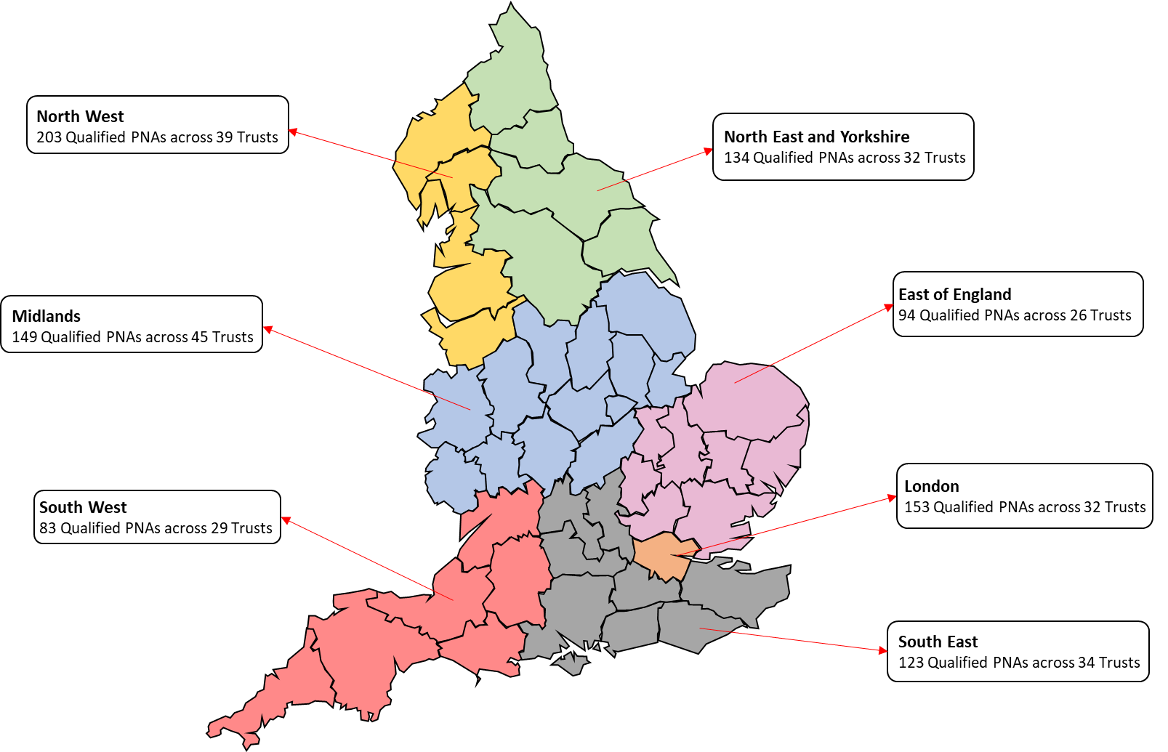
Regional Breakdown of Qualified PNAs
All trusts confirmed as pilot sites across England commenced reporting on providing the Provider Workforce Return (PWR) PNA data from October 2021.
In addition, further reporting on providing the Provider Workforce Return (PWR) PNA data launched for all other trusts in England from 1 April 2022.

Slide 9
Number of Qualified PNAs – Per Nursing Field

Slide 10
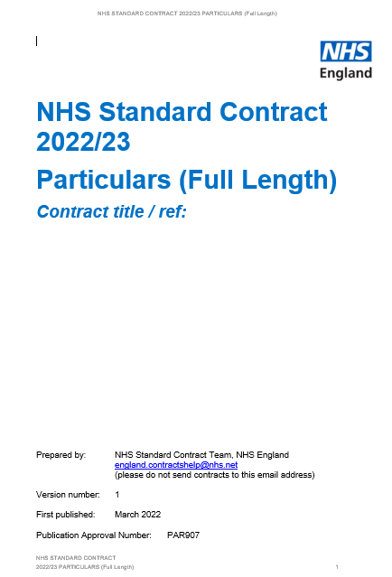
PNA Programme Implementation
National Professional Nurse Advocate Implementation Guide published December 2021: https://www.england.nhs.uk/publication/professional-nurse-advocate-a-equip-model-a-model-of-clinical-supervision-for-nurses/
FutureNHS Platform https://future.nhs.uk/ProfessionalNurseAdvocate/grouphome
Skills for Health e-learning modules published December 2021: https://www.e-lfh.org.uk/programmes/professional-clinical-nursing-leadership/
NHS Standard Contract 2022/23: https://www.england.nhs.uk/wp-content/uploads/2022/03/02-full-length-standard-contract-22-23-particulars.docx
PNA booster sessions offered.
PNA Programme Evaluation and Literature Review commissions currently underway. Economic Evaluation also in progress.

Slide 11
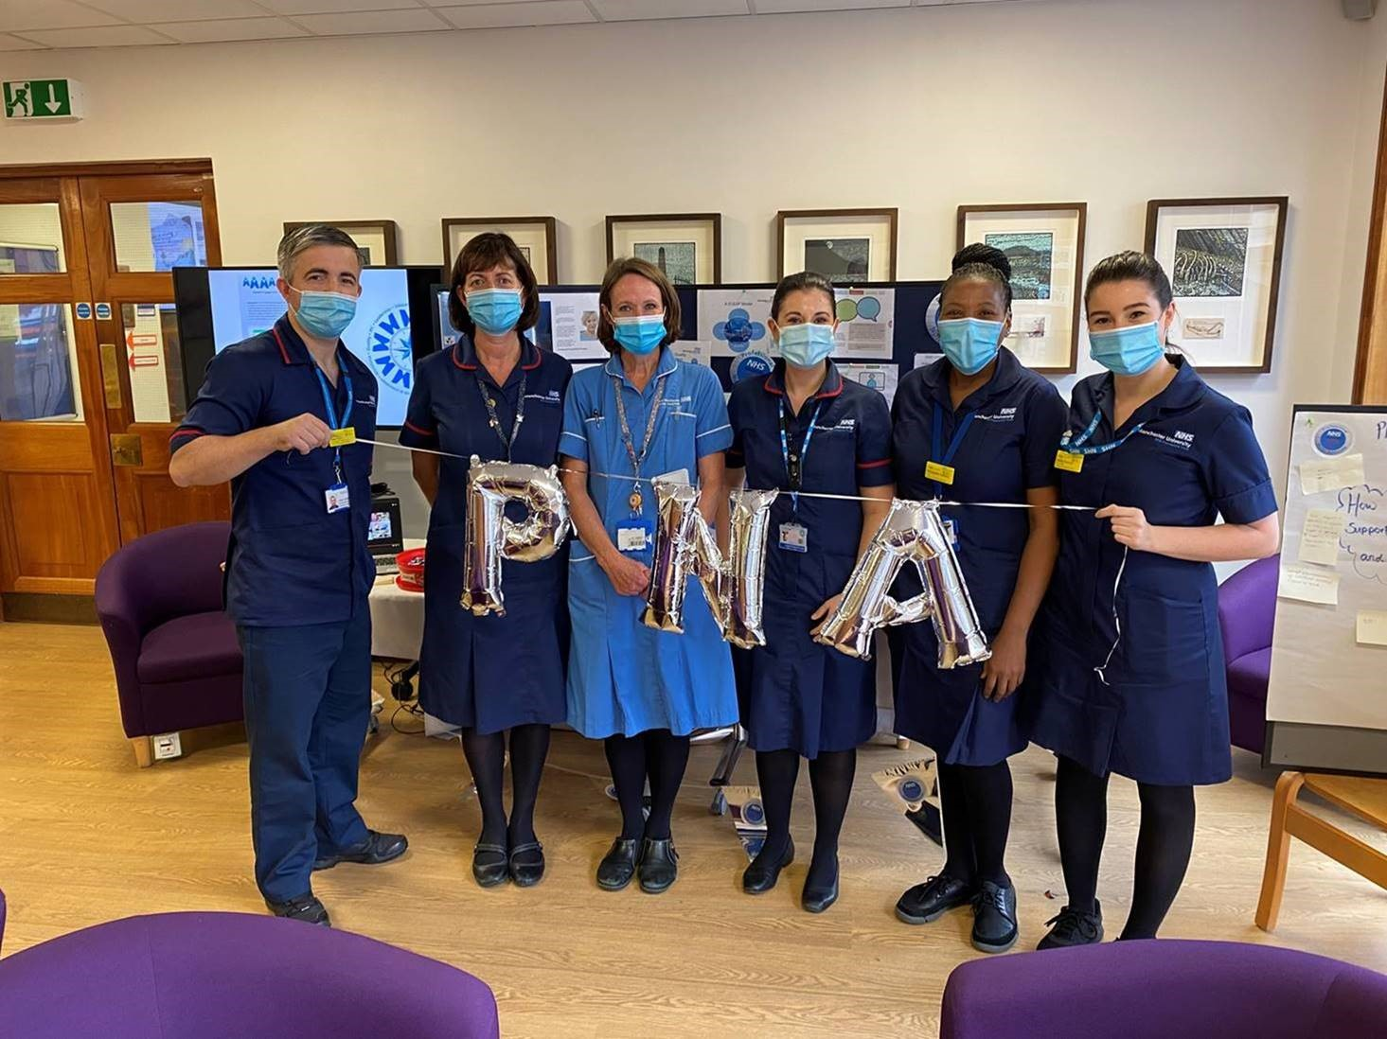
Our Links
PNA Central Team Inbox
england.nursingpna@nhs.net
PNA Webpages
https://www.england.nhs.uk/nursingmidwifery/delivering-the-nhs-ltp/professional-nurse-advocate/
PNA Regional Contacts https://www.england.nhs.uk/nursingmidwifery/delivering-the-nhs-ltp/professional-nurse-advocate/professional-nurse-advocate-regional-teams/

Slide 12
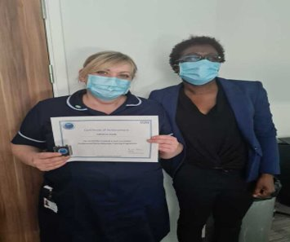
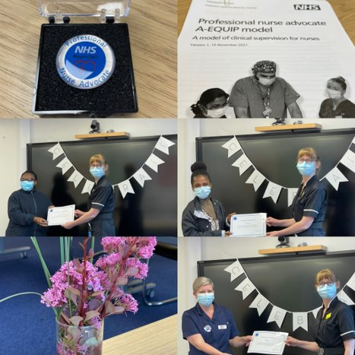
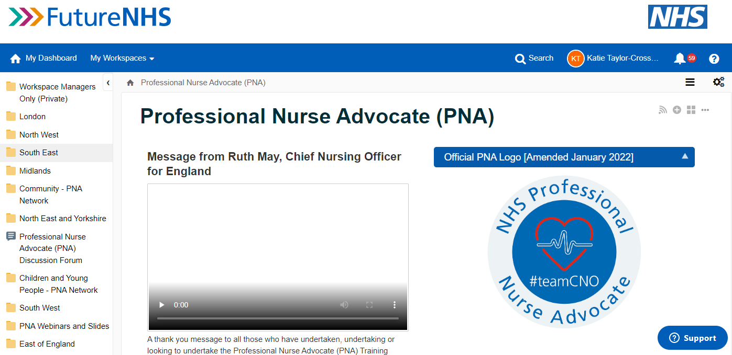
Case study examples and networking available on the NHSFutures space and webpages

Slide 13
Thank you
Any questions?
@nursingemma
Emma.wadey@nhs.net

