Slide 1
Critical Care Nursing Reform NI
Sheila Kinoulty
Interim Nurse Consultant
Public Health Agency
Sheila.Kinoulty@hscni.net

Slide 2
Contents
Delivering Care : A policy framework for
Nursing and Midwifery workforce in Northern Ireland
  Strategic Drivers
  Methodology
Evidence/ Standards
Influencing Factors/ Recommendations
Critical Care Staffing Model 2024
  Applying model- Telford
Challenges/Outcomes/ Next Steps

Slide 3

Delivering Care : A policy framework for
Nursing and Midwifery workforce in Northern Ireland
Notes:
Delivering Care is the policy framework for Nursing workforce in Northern Ireland.
It’s aim is to support the provision of high quality care which is safe and effective, through the development of a framework to determine nurse staffing ranges for service areas.
In NI the Public Health Agency is the delegated authority commissioned by the Northern Ireland Chief Nursing Officer to lead on the framework, working in partnership with Health and Social Care organisations.

Slide 4
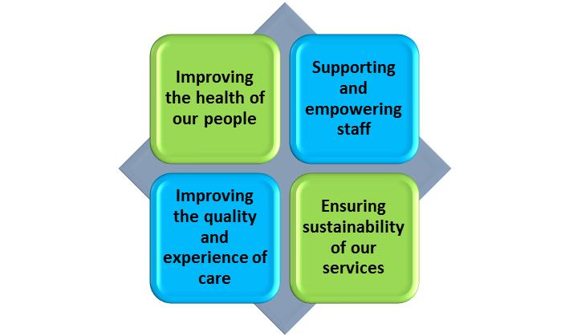
Context
Quadruple Aim Approach
Whole System Focus
Accountability/ governance arrangements.
Corporate priorities across HSC.
Workforce intelligence & robust data collection.
Benchmarking.
Co-production & engagement.
Agree implementation deliverables for each phase. Needs led.
Robust monitoring.
How we do it?
Processes
Person Centred
Priorities
Performance
Professional leadership
What We Want to Achieve?
Safe staffing models for Nursing and Midwifery workforce across NI.
Provision of robust data to inform commissioning investment and forecast workforce planning and training requirements.
Build a sustainable Nursing and Midwifery workforce in NI.

Slide 5

NMTG Key Lens
(Delivering Care)
Maximise the contribution of Nurse’s and Midwives in Public Health and Wellbeing.
Maximise the role Nurses and Midwives make in the transformation of health and social care delivery.
Develop the capacity and capability for nurses and midwives to lead at all levels

Slide 6
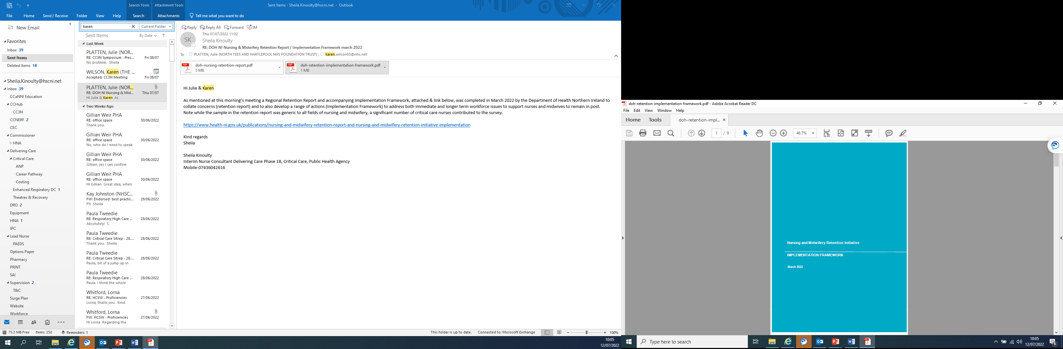
N & M Retention Initiative
Implementation Framework
(Delivering Care)
N & M Retention Initiative
DOH NI 2022
Safe Staffing
Valuing Staff
Leadership
Good Working Conditions

Slide 7
Objectives
Better Outcome and improve Health Care Experience.
Address health inequalities.
Improve health of population.
Services and Workforce Stabilisation and improved morale.
Ensure staff development and career progression i.e. more senior nurse roles, education facilitator roles and leadership roles
Enhanced number of nurses to provide safe and effective care
Innovation – New Ways of Working

Slide 8
Stages
Delivering Care Phase 1B Critical Care Nursing commissioned CNO June 2021
Expert reference group
Literature review
Baseline data
Influencing Factors
Benchmarking analysis
Agreed assumptions including influencing factors following assessment of evidence and expert professional discussion
Recommendations for a safe staffing model and range

Slide 9
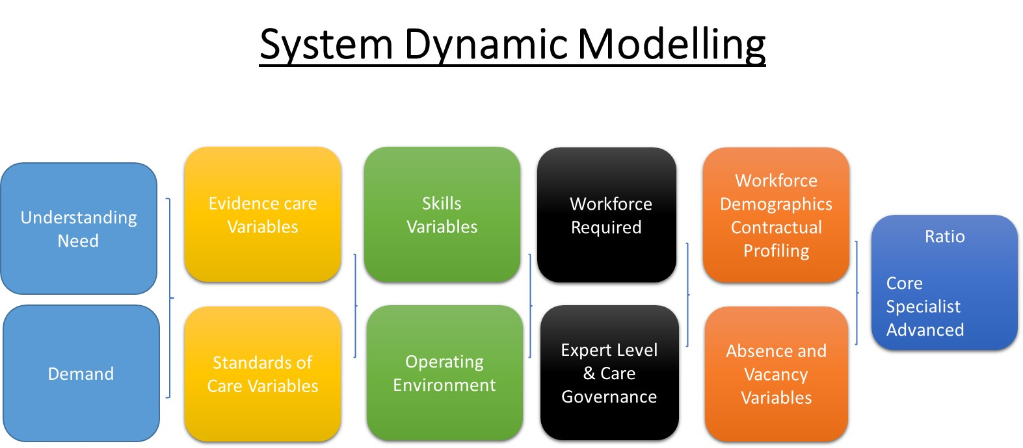

Slide 10
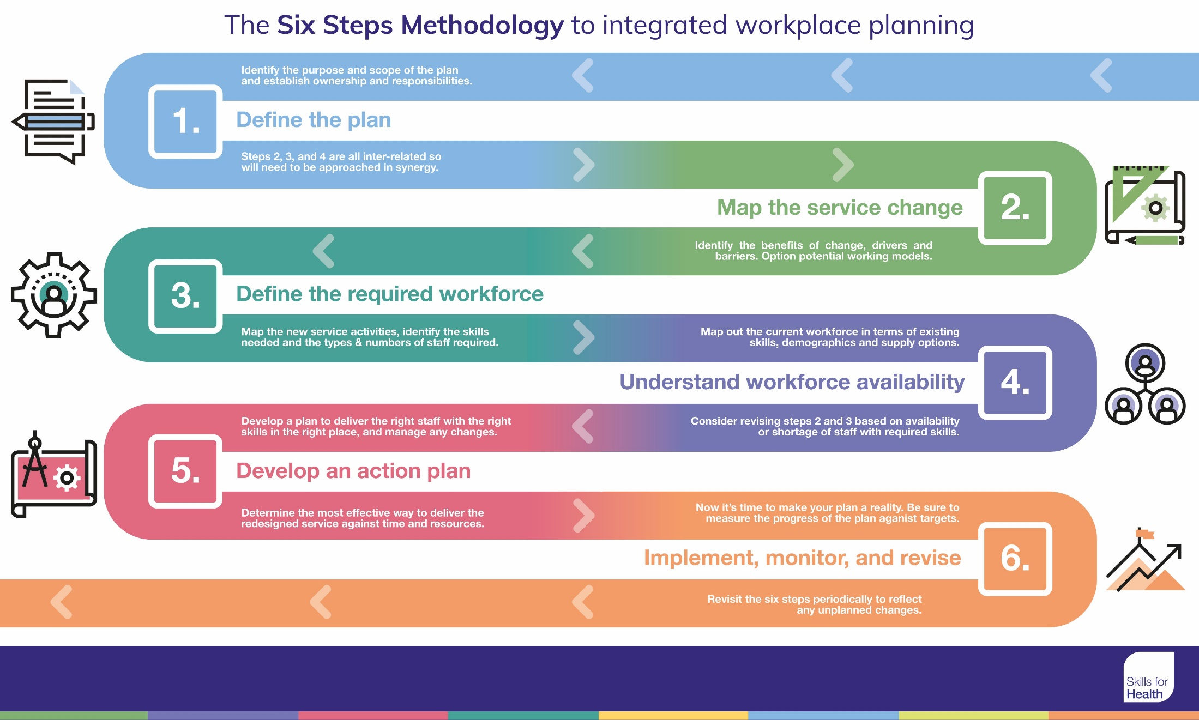

Slide 11
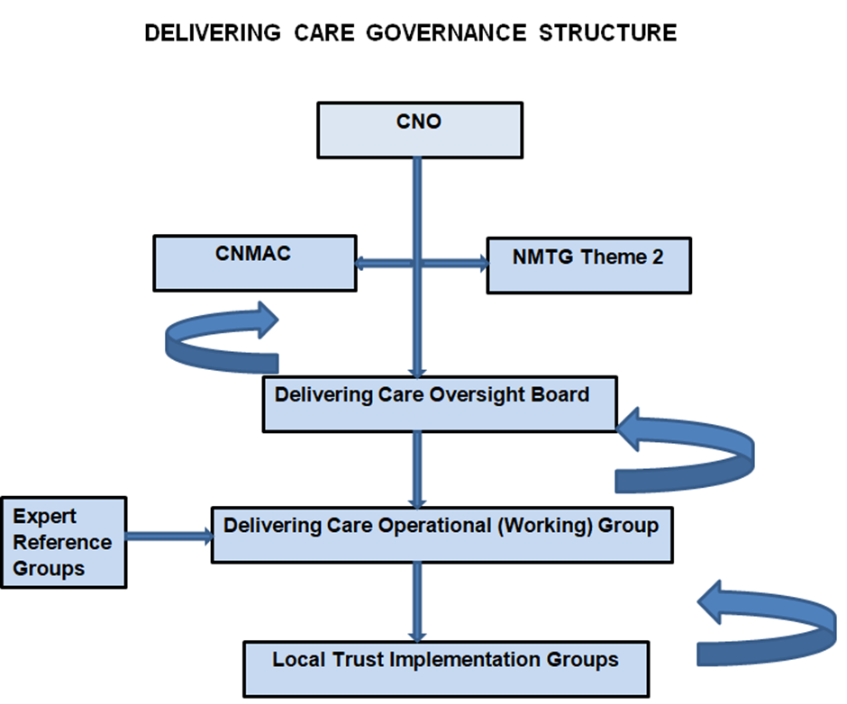

Slide 12
Evidence/ Standards
Section 2

Slide 13
Literature Review
Queens and RCN
12 search terms including, Intensive/ Critical Care/ High Dependency/ Units/Nursing, staff ratio/ skill mix, Critically ill patients/ illness
164 Articles found, 40 studies analysed provided little usable information on the practical use of staffing tools in practice

Slide 14

Propose that patients’
needs are determined according to the level of care which their condition requires, rather than according
to the designation of the bed in which they happen to lie
Flexible use of staff is recommended with a move away from the use of rigid ratios to determine nurse
staffing for patients requiring Level 2 and 3 care to the use of more flexible systems for assessing nursing
workload
2000

Slide 15


Describes the care a patient
requires,
not where they are receiving it, nor does it measure the actual care being delivered
Level of care assigned will influence, but not determine staffing requirements & the aim should be flexibility in the provision of staff resources to meet the needs of the patient- ICS 2009 / GPICs 2019
2021

Slide 16
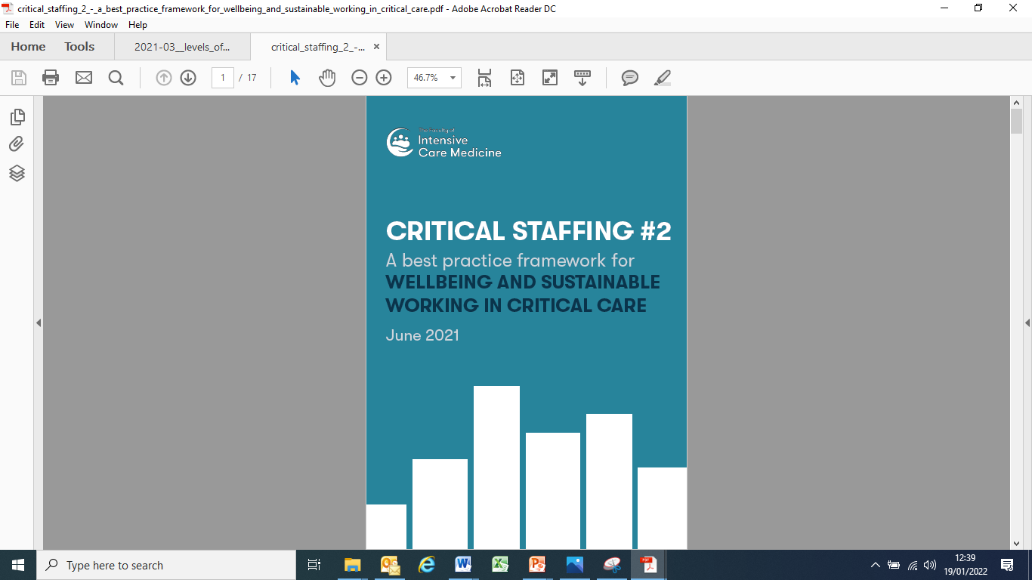

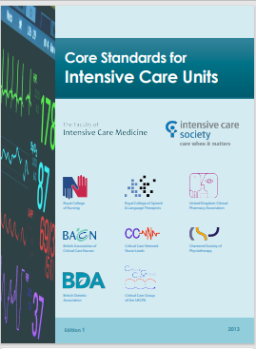


National Standards

Slide 17
Core Standards
Standard
Additional rationale/ consideration
Level 3 patients must have a registered nurse/patient ratio of a minimum 1:1 to deliver direct care
Level 2 patients must have a registered nurse/patient ratio of a minimum of 1:2 to deliver direct care
  Ratio may need to be higher i.e. unstable patients requiring various simultaneous nursing activities and complex therapies…..
  Ratio may need to be increased to 1:1 to safely meet the needs of critically ill patients i.e. those confused or delirious requiring close monitoring

Slide 18
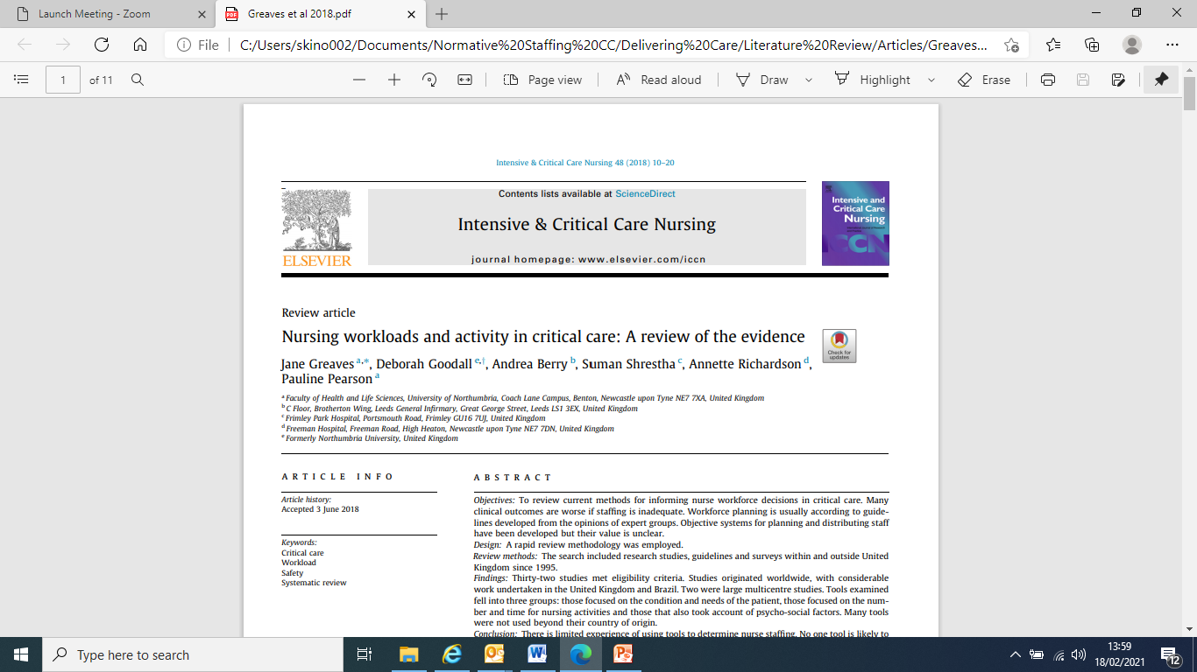
While national standards acknowledge increased nurse to patient ratios may be required to safely meet the needs of some critically ill patients due to severity of illness and related nursing demands (Level 3 patients) and close monitoring or those being nursed in a sideroom (Level 2 patients) there is no validated tool, at this time, to quantify this occurrence.

Slide 19
Influencing Factors
Recommendations
Section 3

Slide 20
Influencing Factors- ERG
Workforce- Safe Staffing
Health & Wellbeing Hydration/ Nutrition
Clinical & Restorative Supervision Induction CPD
Activity
Casemix
Transfers
Ward Rounds
Family Support
Rehabilitation Needs
Environment
Geographical location
Isolation Rooms
Side-rooms
Supporting infrastructure
Tertiary Centre
Risk management continuous nursing observation
clear and safe pathway from L2 to L3
- Patients need a clear & safe pathway from L2 to L3 care
-L2 patient can require more nursing care than a sedated L3 patient
Resilient Staffing model
-buffer expansion activity demand
No tool has been demonstrated to be superior to the professional judgment of an experienced nurse manager for staffing decisions

Slide 21
Recommendations-
In addition to Core Standards/ GPICs
Offset increase in patient/service requirements as indicated above
All CC beds in mixed Adult General CCU’s, of NI will allow for 1 nurse per bed to enable the NIC to utilise their professional judgment to allocate the appropriate number/ skill mix of nurse to patients across the CCU
Threshold for an additional nurse is reduced from 10 to 8 beds, at Senior Nurse Level for; family liaison, KPIs, Audit, IPC, Clinical & Restorative Supervision etc.
Time for meal breaks and handover are built into workforce planning

Slide 22
Recommendations-
In addition to Core Standards/ GPICs
Band 7 Sister/ Charge Nurse 24/7 to take responsibility for the critical care unit- high level clinical decision making and nurse staff support required - ensuring that mechanisms to mitigate nursing stress and burnout are implemented and evaluated.
Adequate Senior Nursing/ Nursing Assistant Support is pivotal to delivering person-centred care therefore
  2 Senior Nursing Assistants proportionate for an 8 bedded unit 24/7
  1 Nursing Assistant 12 hrs/ day 7 days a week
All units dedicated Clinical Educator proportionate to 1 WTE per circa 50 staff (HEE working group)

Slide 23
Recommendations-
In addition to Core Standards/ GPICs
All newly appointed critical care nurses – 12 weeks supervised practice for STEP 1 competencies
Senior Nurse CIS oversight to ensure MD development and maintenance of the system, benchmark standards etc.
An allowance proportionate to the size of unit is recommended e.g. 22.5 hours 8-10 bedded unit, equals 0.74 WTE with 24% Planned and Unplanned Absence Allowance.
In line with recent nursing studies- up to ⅓ of nursing activities consist of non-professional nursing tasks such as housekeeping or clerical duties (Grosso et al JNM 2021).
  Range of support staff e.g. domestics, ward clerks, receptionists, data clerks, analysts, secretarial and administrative staff.

Slide 24
Influencing Factors- ERG
Improving Patient Outcomes
Research
World Class
Clinical Excellence
Excellence
Safety
Quality Improvement

Slide 25

Strengthen Clinical Leadership
Nurse In Charge 24/7
Clinical Leadership, ensuring HQ safe effective patient care, equity/ timely access- discharge, MDT, Liaises Departments, specialities, facilitates CPD
Lead Nurse Band 8A
Person-centred outcomes, care environment, supportive organisational systems, potential for improvement and innovation, shared decision making, staff development.
ANP Patients needs, recognising acutely ill patients, initiating early treatment, supports patients through critical illness, enhance continuity and quality of care.
Create new Clinical Nurse Specialist role in the field of CC
- evidence that specialist nurses improve clinical care outcomes
- strengthens clinical practice role
Clinical Nurse Co-Ordinator
Coordinate, supervision and support teams to optimise safe standards of patient care on each shift. Continuity of care. Facilitate admissions and discharges to ensure efficient and effective patient flow.
Senior Staff Nurse
Support Family Liaison, KPI’s, Audit, IPC, Staff Supervision and operational support, relief make up medications etc., rehabilitation needs, MDT support
Senior Staff Nurse Expert
Staff Nurse
Assess, plan, implement and evaluate care for critically ill patients.
Person- centred Outcomes

Slide 26
Critical Care Staffing Model 2024
Application Model- Telford
Section 4

Slide 29
Telford aligned to model
Direct Patient Care
Skill Mix Registered |  | 83.4%
Skill Mix Unregistered |  | 16.6%
Band Mix 8a |  | 10.2%
Band Mix 7,6,5 |  | 89.8%
Band Mix 7 |  | 25.0%
Band Mix 6 |  | 65.0%
Band Mix 5 |  | 10.0%
Band Mix 3 |  | 80.0%
Band Mix 2 |  | 20.0%

Slide 30
Challenges/ Outcomes/ Next Steps
Section 5

Slide 31
Challenges
Understanding Process- Delivering Care
In NI Commissioned by CNO
Duration
Paper- fairly straightforward, collating information etc.
Regional Telfords-
  Multiple iterations, testing, agreeing principles e.g. Band 6 allowance.
  Tertiary centre more requirements e.g. nursing assistant support for log rolling etc.- all documented in paper.
  Uplift direct clinical care only.
  Aligning to model

Slide 32
Challenges
Managing Expectations- degree of frustration amongst colleagues
Competing demands across all fields of nursing

Slide 33

Strategic Investment 21 -22
Critical Care and Operational Hub
NMTG - Strengthen the clinical Critical Care nursing workforce by investing in 25 Senior Staff Nurses through Delivering Care allocation.
HSCB/ PHA - Strengthen the clinical Critical Care nursing workforce by investing in 5 Trainee Advanced Nurse Practitioners.

Slide 34

Implementation Plan
Career Framework/ Pathway
  Formal CNO ratification and publication
  Staged approach
  Lead in time for preparation of Senior Staff Roles e.g. Specialist Nurse Role
  Prerequisite competencies to roles/ Job descriptions/ Personnel Specifications
  Identify the distinguishing characteristics of the roles and the related knowledge and skills
  Investment linked to improved patient outcomes
  CNO commissions NIPEC to coproduce and co-design Career Framework with key stakeholders

Slide 35
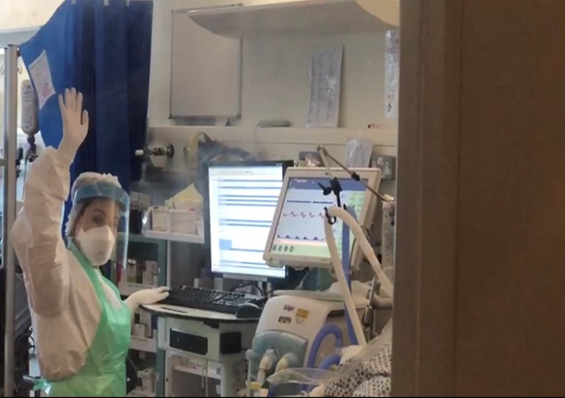
Thank you

Slide 36

Professional Nurse Advocate (PNA): Introducing the PNA role Across England
Dr Emma Wadey, Deputy Director Mental Health Nursing
Friday 15 July 2022
#teamCNO
#PNA
#Professional Nurse Advocate
#PNAdvocates

Slide 37


COVID-19 Pandemic

Slide 38

What we knew…..
Emotional impact of Nursing
Nurse risk factors
Workforce gaps
Need for universal mental health and wellbeing support
Desire for accredited clinical and professional development

Slide 39

What Was Wanted
To be valued
To be invested in
Nurse led initiatives
Restorative clinical supervision
Leading recovery and transformation
Recognised and credible qualifications and continuous professional development

Slide 40
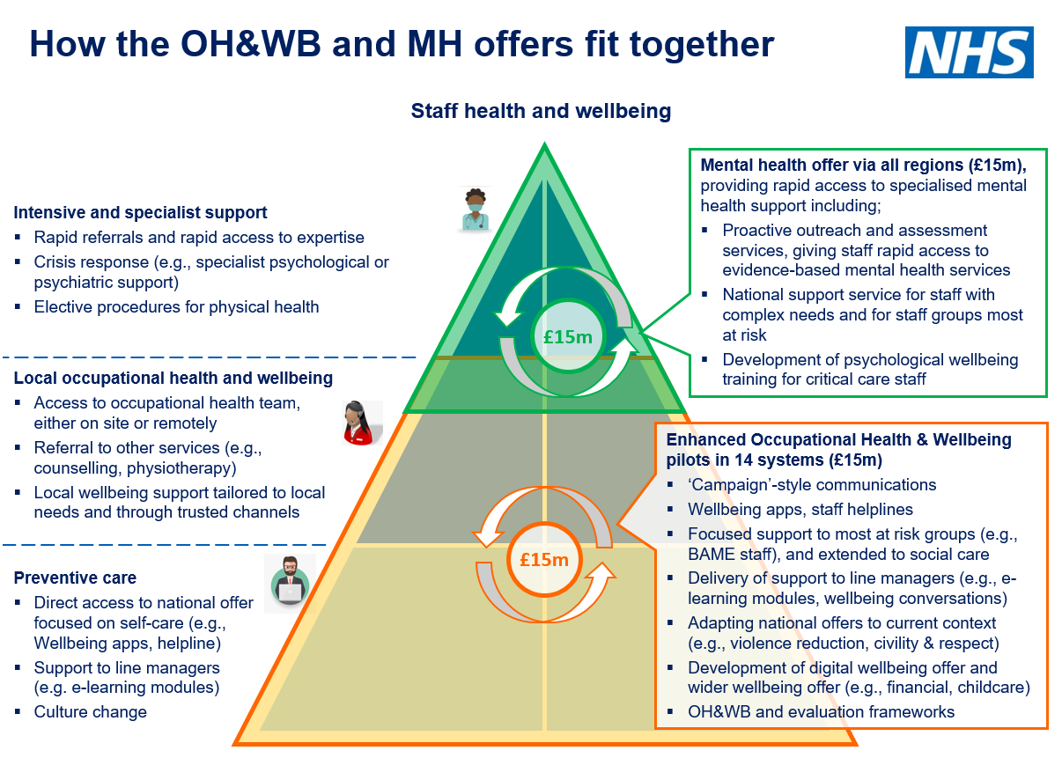
What we did: Integrated staff mental health support offer
3 key components to the work programme
Established 40 system-wide mental health and wellbeing hubs which provide proactive outreach and assessment services, ensuring staff receive rapid access to evidence based mental health services and psychosocial support where needed​
A national enhanced mental health service for staff with complex needs, delivered by NHS Practitioner Health ​
Providing 5000 training places in the Professional Nurse Advocate program for registered Nurses by April 2022 so they can provide restorative supervision for their teams
Progress to date in establishing MH&WB hubs
40 local areas have now established their mental health and wellbeing hub and are taking referrals.
NHSE/I website has a regional navigation panel to find out details of the staff mental health and wellbeing hub which covers either the area staff work in, the area staff live in or both.
The national NHSE/I team have put in place support for systems to mobilise hubs at pace:
  Supporting the establishment of regional staff mental health support networks
  National webinars on good practice and guidance
  Future Collaboration site with FAQs, guidance and good practice examples
  Offer of support including – buddying, expert clinician support, system deep dives.
We will be supporting hubs to undertake proactive outreach to ICU/critical care teams in their local area if that has not happened yet.
Enhanced mental health service
NHSE/I has also worked with NHS Practitioner Health to put in place an enhanced mental health service where hubs can refer the smaller percentage of staff that may have more complex needs (such as trauma or addictions).
This service can offer access to prescribing clinicians, access to addiction services and interventions focused on trauma. The service can also provide case management and support return to work.
Referral to the service is via the mental health and wellbeing hubs, however staff at grade 8d and above can self-refer to the service.

Slide 41

The Professional Nurse Advocate Programme
The PNA programme builds on the success of the PMA program and delivers training and restorative supervision for colleagues across England. ​
Launched in March 2021, towards the end of the third wave of COVID-19. This was the start of a critical point of recovery: for patients, for services and for our workforce.​
Course content focuses on the four functions of the Advocating for Education and Quality and Improvement (A-Equip) Model, with a focus on restorative clinical supervision. The four functions of the A-Equip Model are as follows:​
  Clinical Supervision (Restorative)​
  Monitoring, Evaluation and Quality Control (Normative)​
  Personal Action for Quality Improvement​
  Education and Development (Formative) ​
PNA Training equips nurses to lead and deliver quality improvement initiatives in response to service demands and the ongoing changing patient requirements. It also provides the necessary skills to facilitate restorative supervision to colleagues and teams within nursing services and beyond.

Slide 42
PNA Programme Overview
Ambition to have 1:40 registered nurses trained as PNAs across England by 2023 and 1:20 by April 2024
A total of 4,723 registered nurses (1:60) have now completed their PNA training since early March 2021 across all areas of NHS commissioned care and in all 4 fields of Nursing practice. This includes 292 critical care nurses.
Recruitment of 7 regional PNA advisors & PNA leads in very trust
Three key metrics collected monthly –
1. Number of Restorative clinical supervision sessions offered
2. Number of QI projects involving PNAs
3. Number of career/professional development conversations offered.

Slide 43
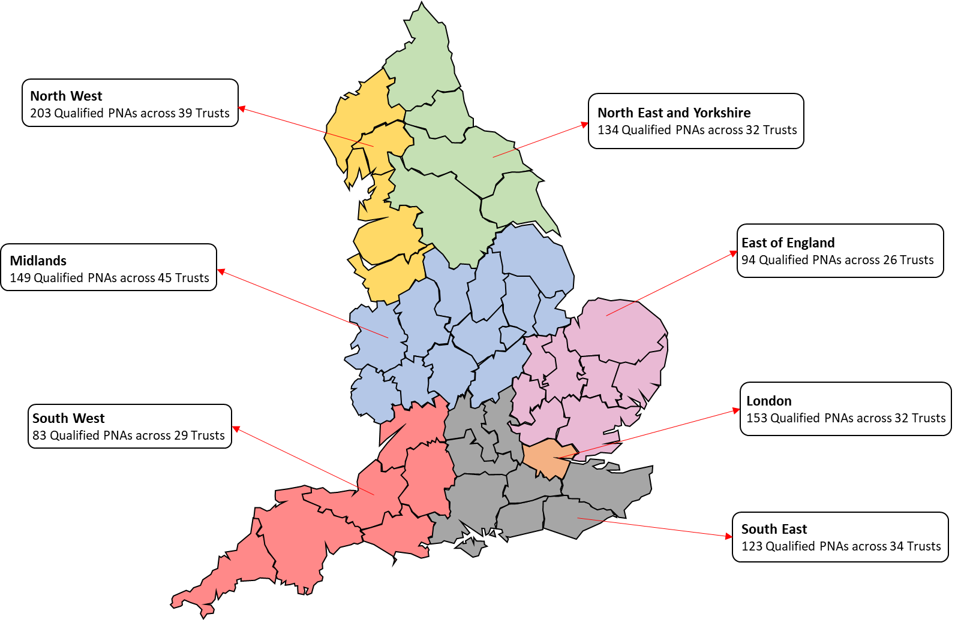
Regional Breakdown of Qualified PNAs
All trusts confirmed as pilot sites across England commenced reporting on providing the Provider Workforce Return (PWR) PNA data from October 2021.
In addition, further reporting on providing the Provider Workforce Return (PWR) PNA data launched for all other trusts in England from 1 April 2022.

Slide 44
Number of Qualified PNAs – Per Nursing Field

Slide 45


PNA Programme Implementation
National Professional Nurse Advocate Implementation Guide published December 2021: https://www.england.nhs.uk/publication/professional-nurse-advocate-a-equip-model-a-model-of-clinical-supervision-for-nurses/
FutureNHS Platform https://future.nhs.uk/ProfessionalNurseAdvocate/grouphome
Skills for Health e-learning modules published December 2021:
https://www.e-lfh.org.uk/programmes/professional-clinical-nursing-leadership/
NHS Standard Contract 2022/23: https://www.england.nhs.uk/wp-content/uploads/2022/03/02-full-length-standard-contract-22-23-particulars.docx
PNA booster sessions offered.
PNA Programme Evaluation and Literature Review commissions currently underway. Economic Evaluation also in progress.

Slide 46
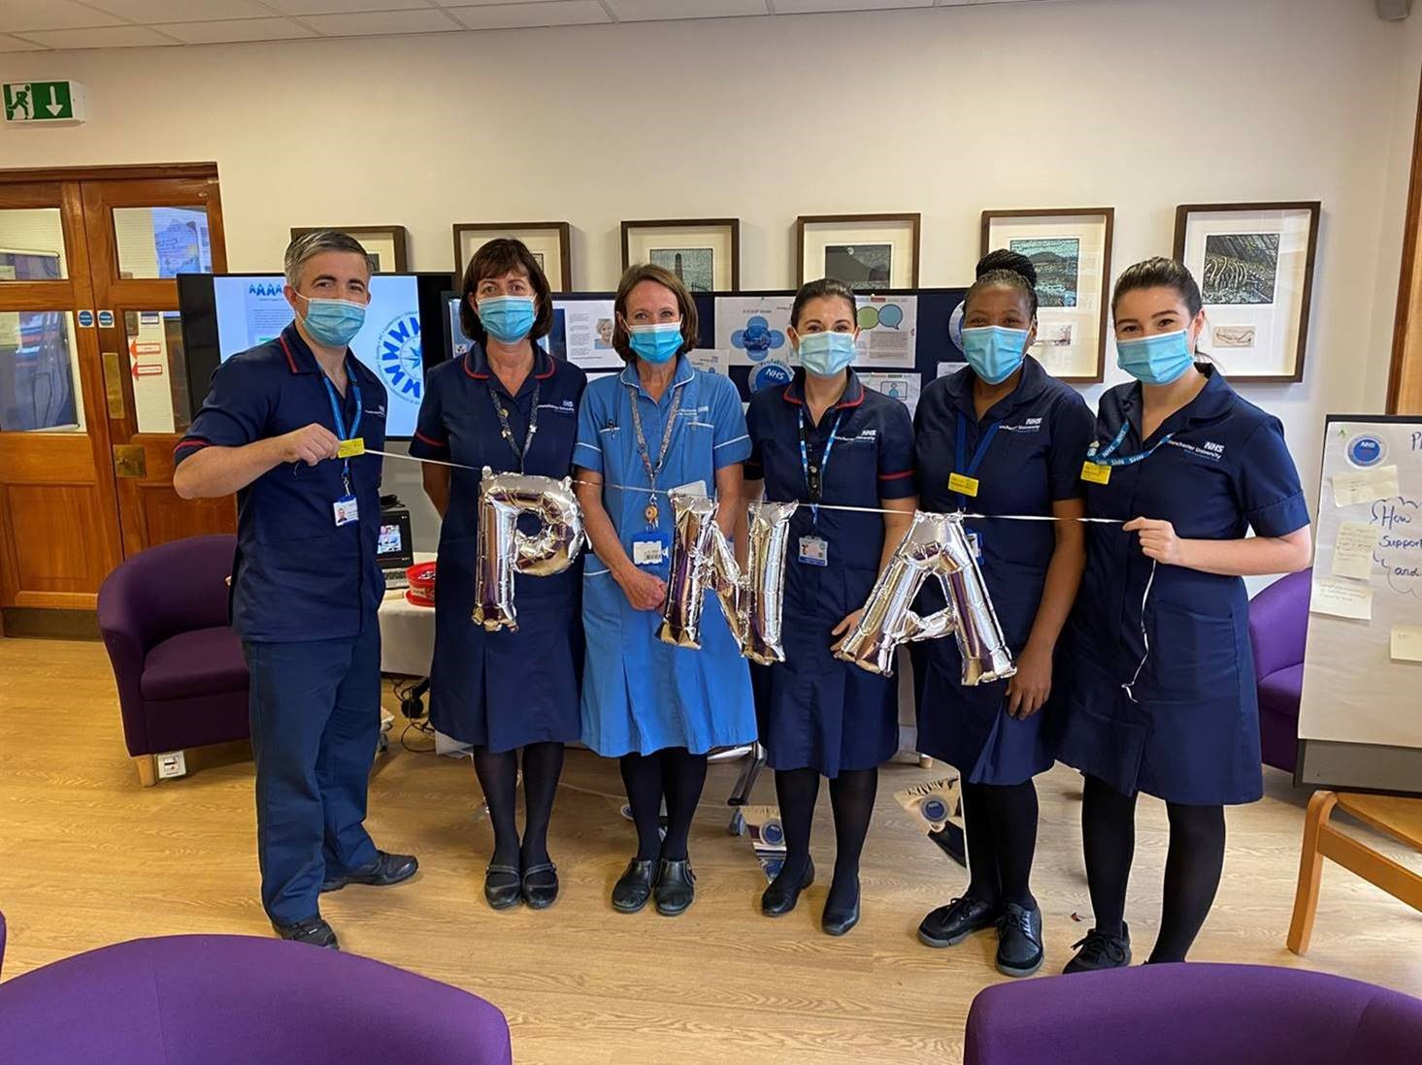
Our Links
PNA Central Team Inbox
england.nursingpna@nhs.net
PNA Webpages
https://www.england.nhs.uk/nursingmidwifery/delivering-the-nhs-ltp/professional-nurse-advocate/
PNA Regional Contacts https://www.england.nhs.uk/nursingmidwifery/delivering-the-nhs-ltp/professional-nurse-advocate/professional-nurse-advocate-regional-teams/

Slide 47
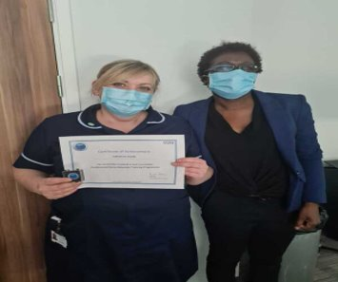


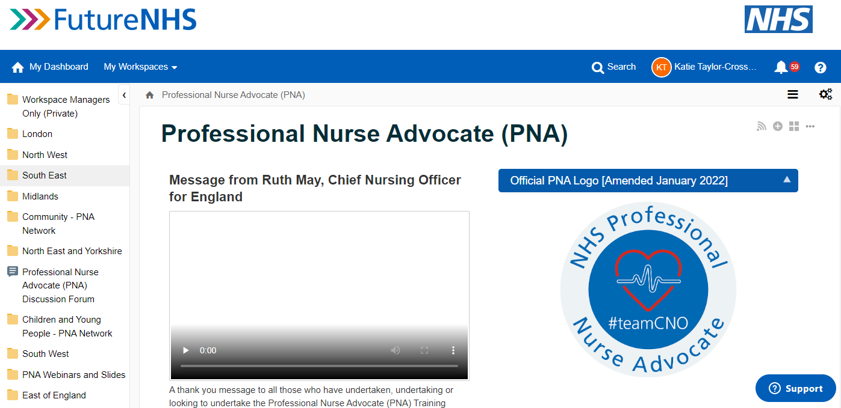
Case study examples and networking available on the NHSFutures space and webpages

Slide 48

Thank you
Any questions?
@nursingemma
Emma.wadey@nhs.net

Slide 49


Digitalisation of Step 1 Adult Critical Care competencies
CC3N symposium, 15 July 2022

Slide 50




Who are we?
Content owners
Critical Care Networks National Nurse Leads ​(CC3N)
Platform owner
Health Education England Technology Enhanced Learning (HEE TEL)
Co-design & delivery support
NHS Elect

Slide 51

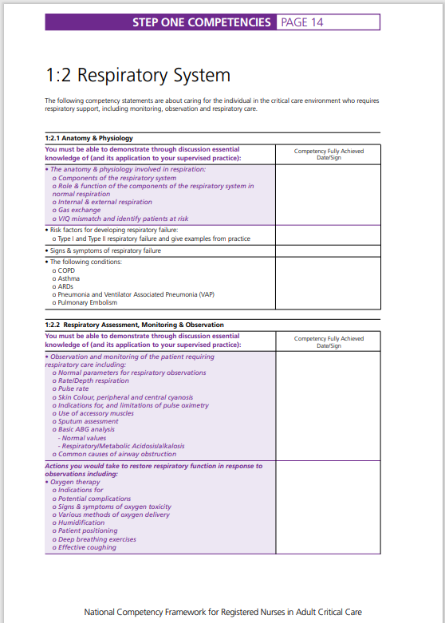

What are we digitalising?
PDF document
700 competencies
For all qualified new CC nurses
Completed over 6–12 months
Used nationally

Slide 52

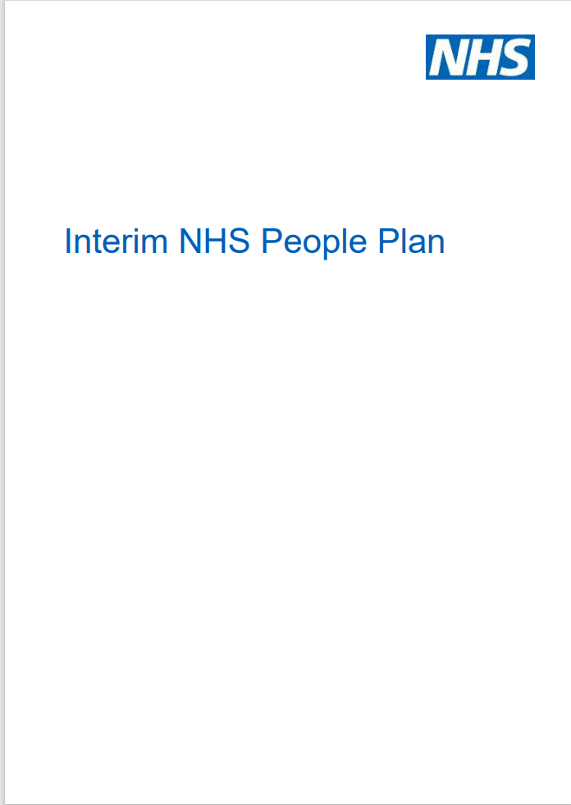

Why are we digitalising the Step 1 competencies?
There is the need and opportunity to:
Grow and transform our workforce using emerging technology
Improve the digital literacy of our staff
Use digital technology to improve patient care and release more time for care
Notes:
https://www.longtermplan.nhs.uk/wp-content/uploads/2019/05/Interim-NHS-People-Plan_June2019.pdf
Blended learning
Digital – check re: opportunities

Slide 53






Opportunities of digitalisation
Quality assurance
Improved standardisation & control of use
Patient safety
Ability to update content more easily
Workforce planning
National visibility of staffs’ skills data
‘Digital first’ workforce
Opportunity to improve digital literacy
Staff mobility
More efficient transfer of staffs’ skills data
Resource requirements
Reduced wastage of staff time & paper
Visibility across competency frameworks
Opportunity to more easily see skills required for different roles, across care settings and professions

Slide 54



Programme approach
Establish need
Edit content & develop digital platform
Testing
National pilot
Sep ’21 – July ‘22

Slide 55
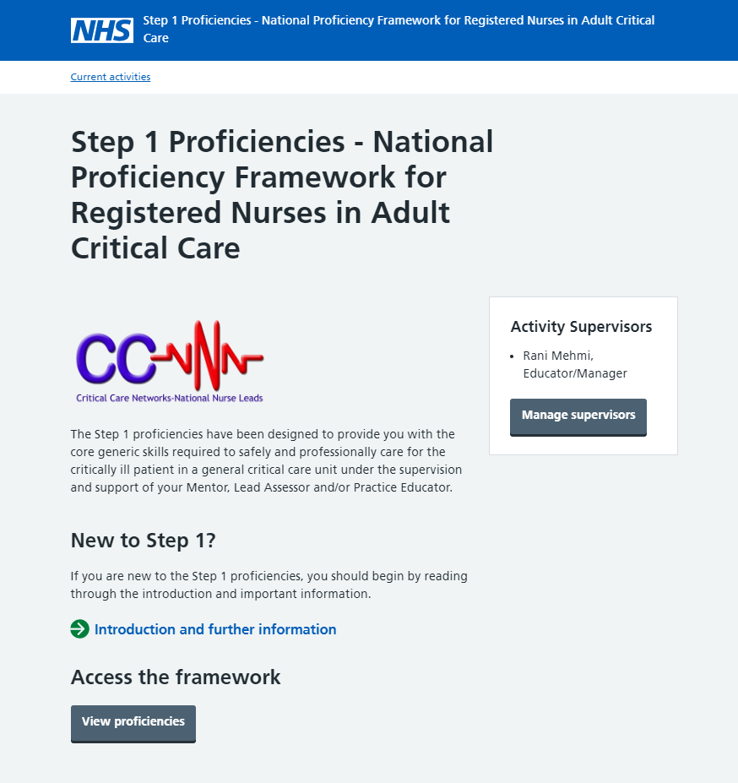

Slide 56
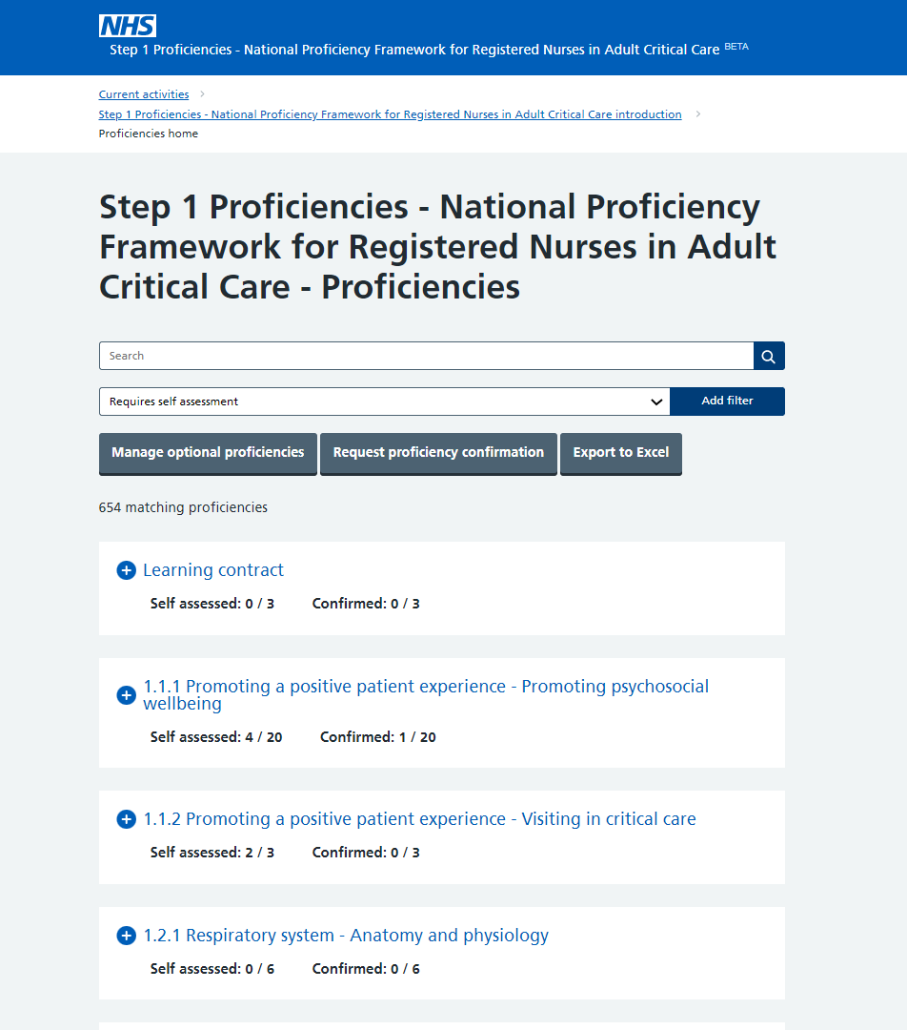
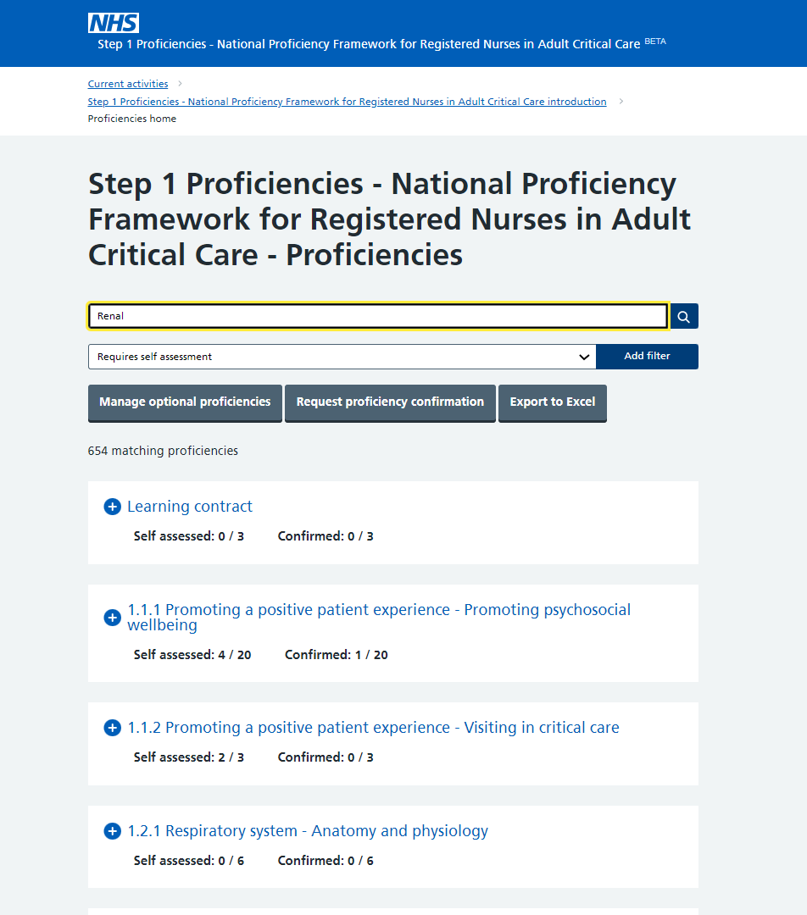
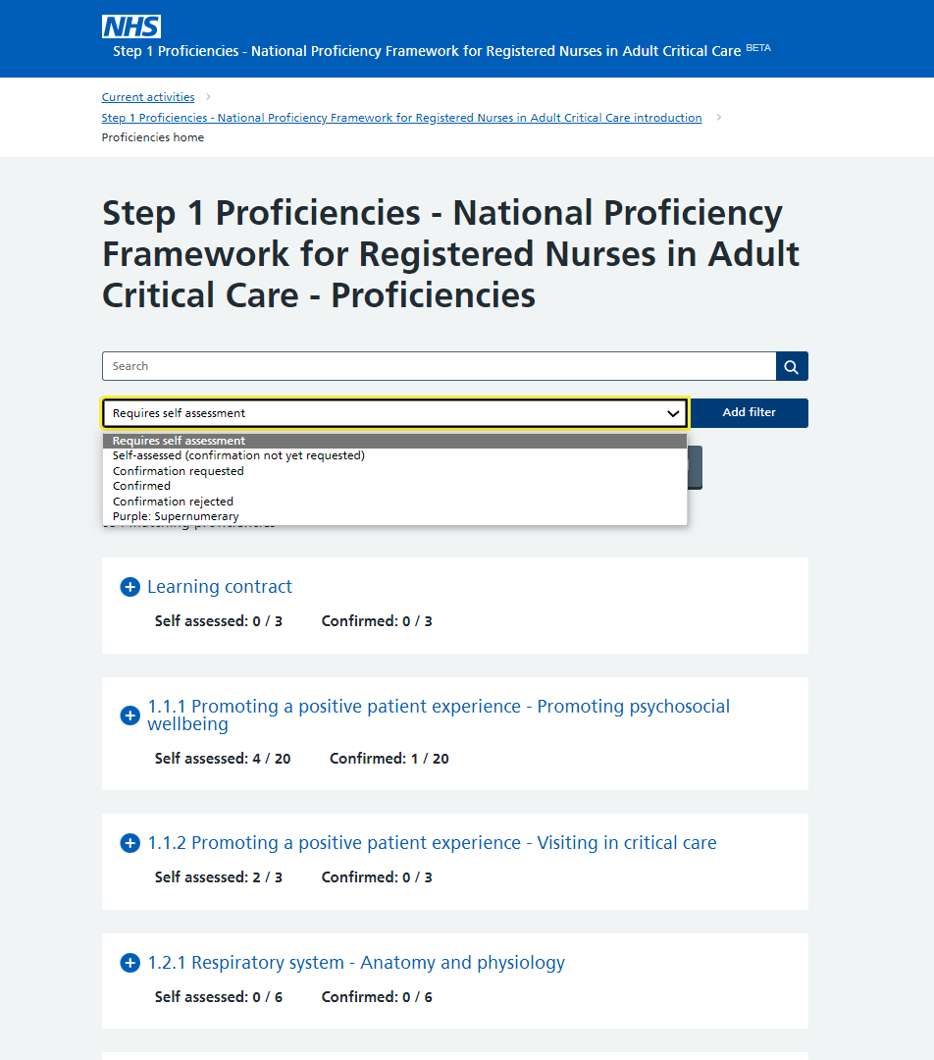

Slide 57
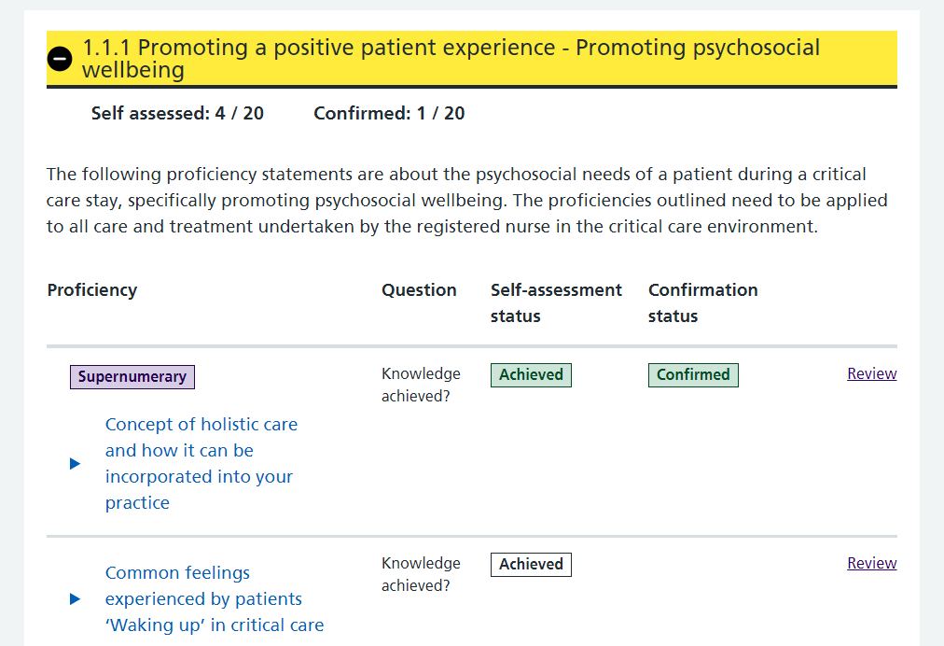
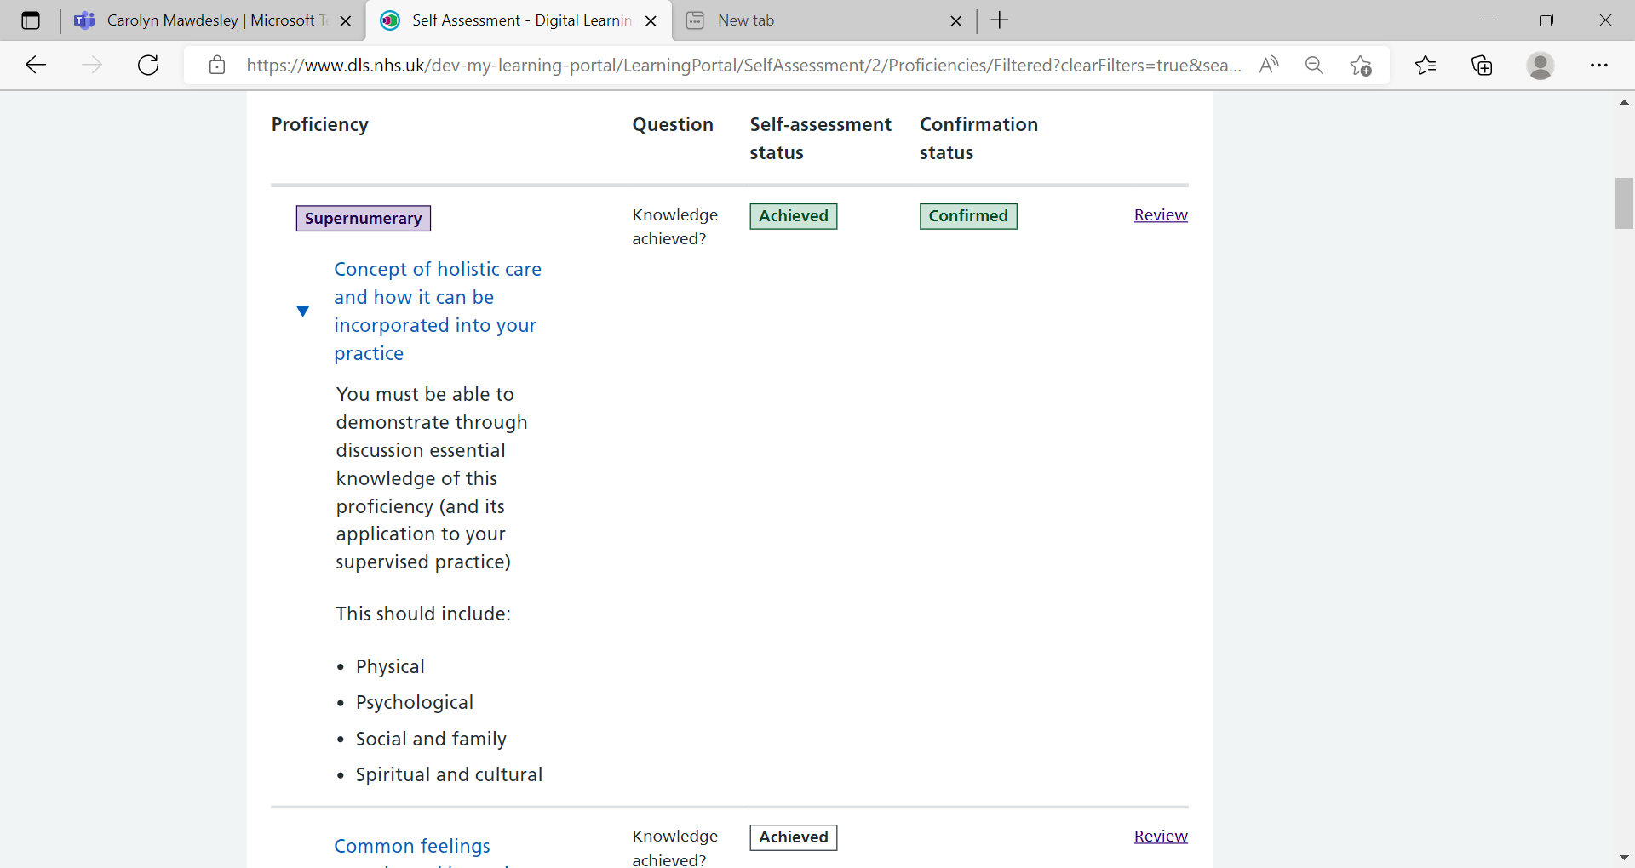
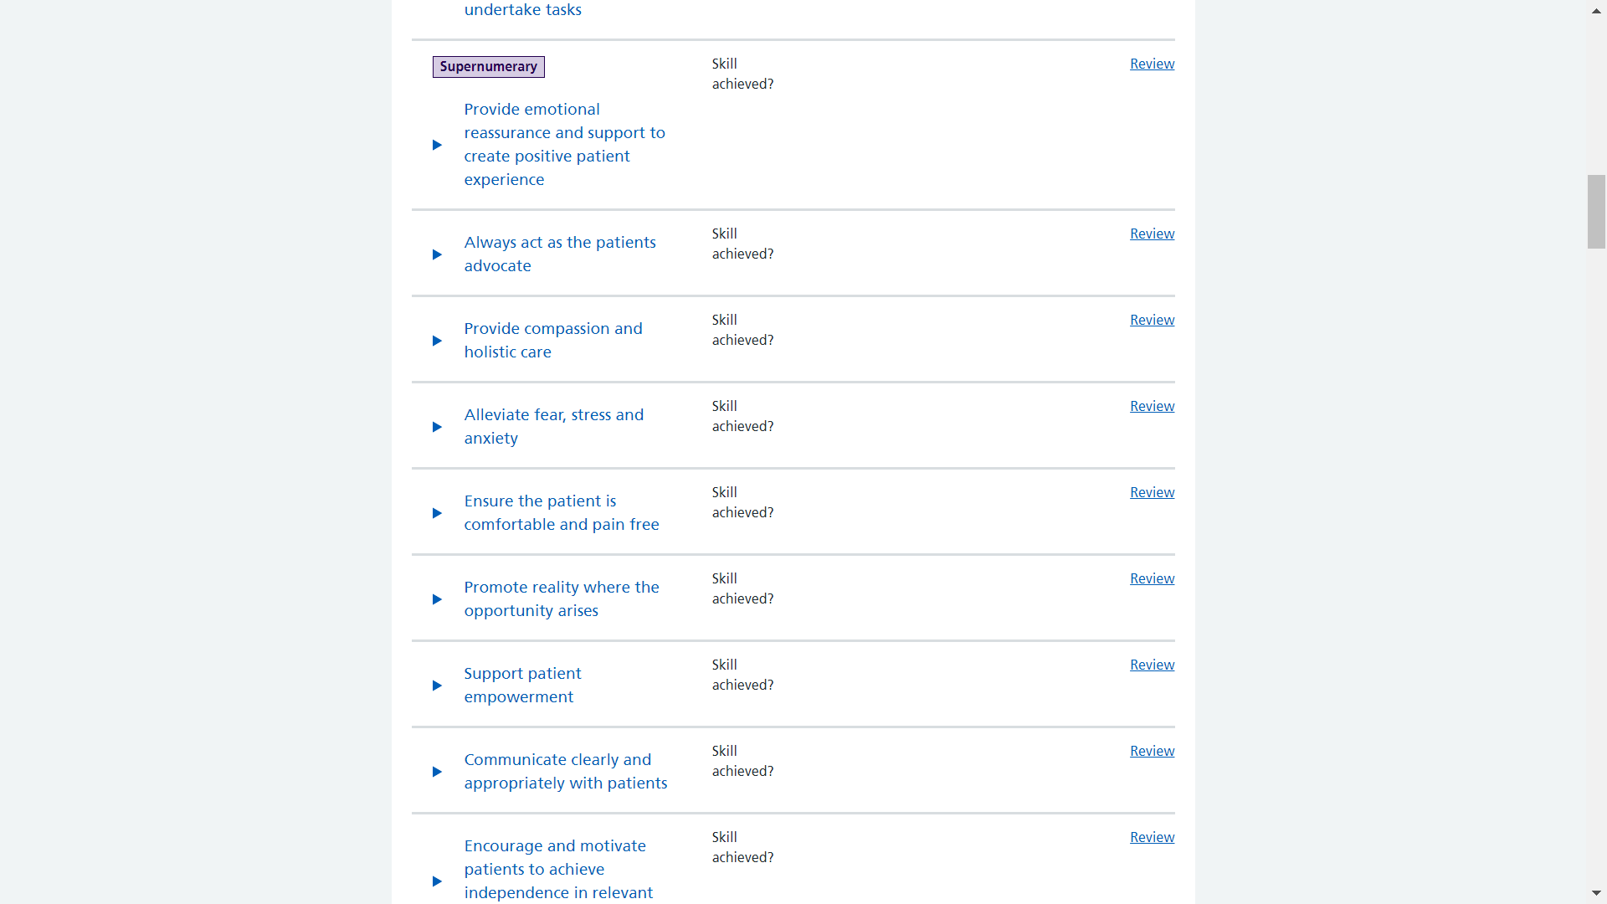

Slide 58
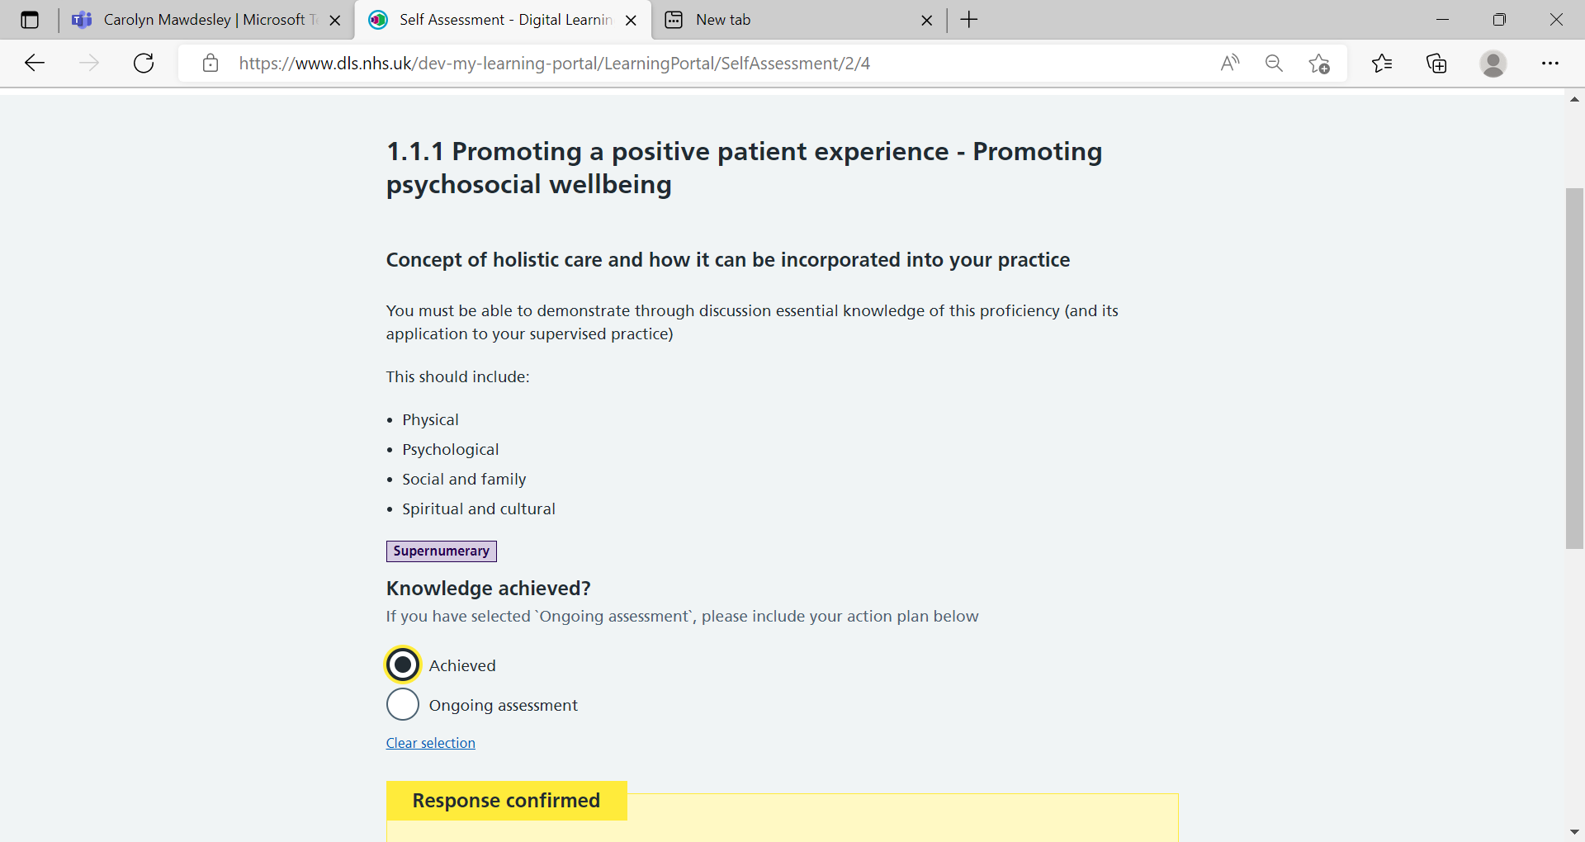
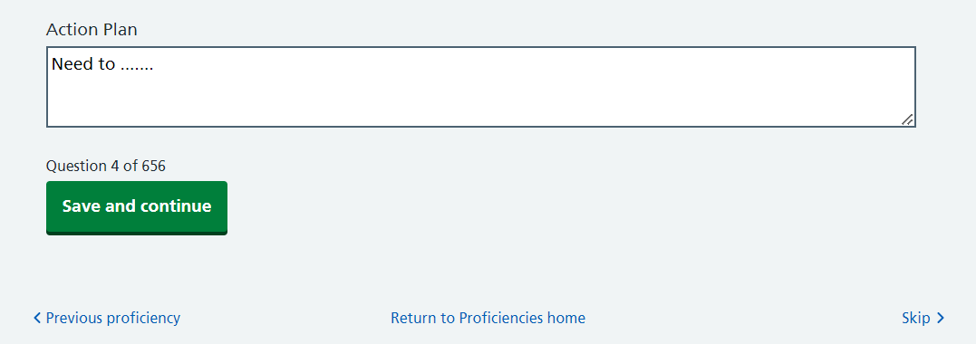

Slide 59
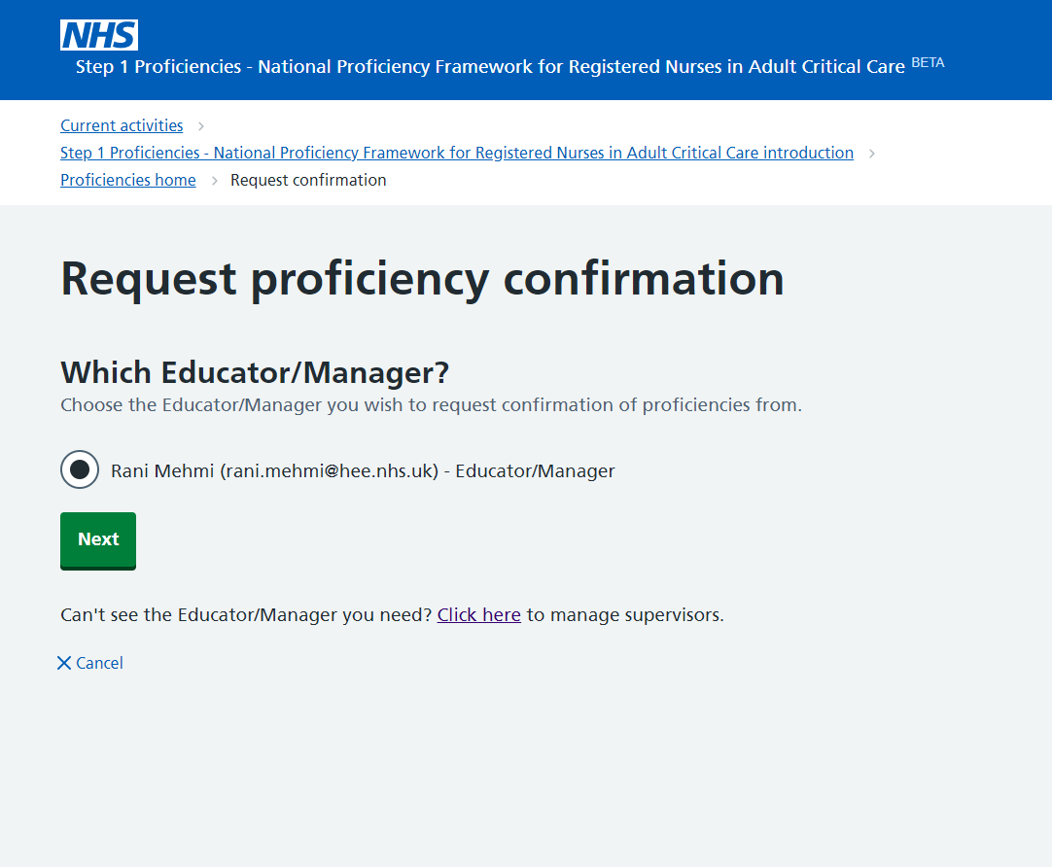
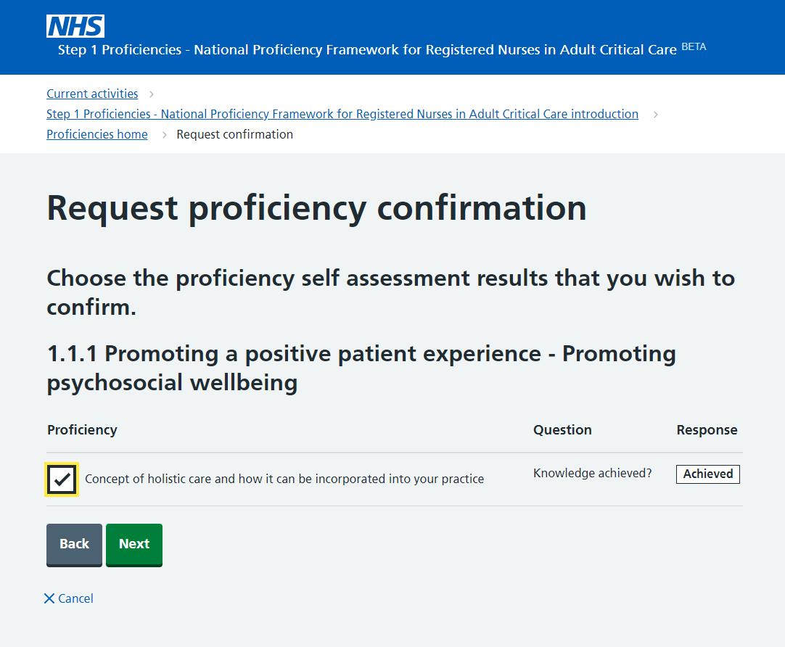


Slide 60
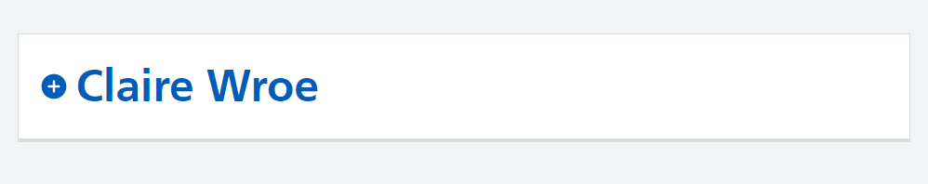
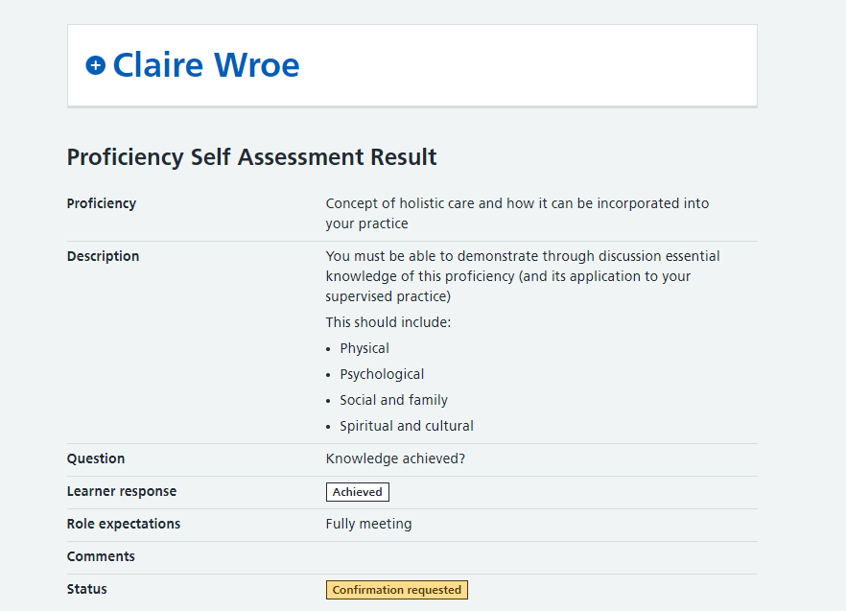
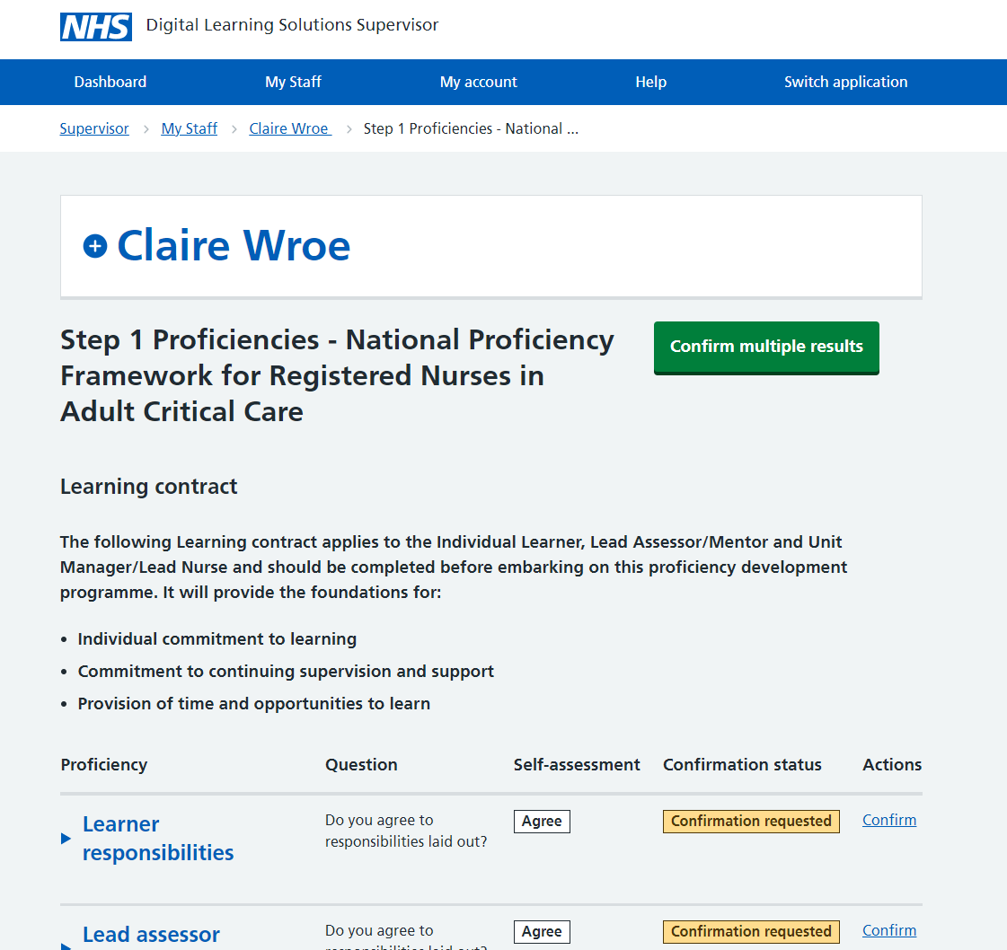
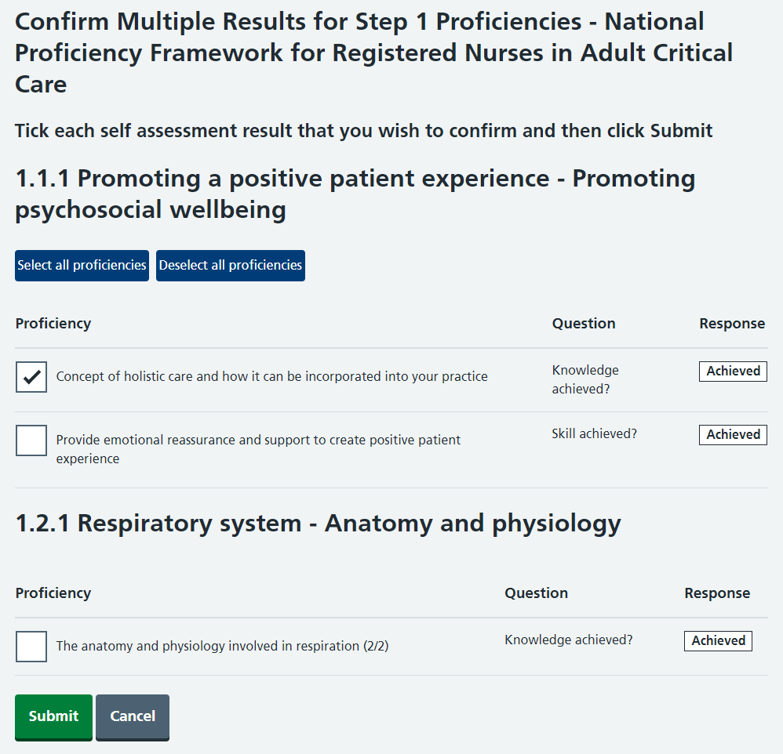
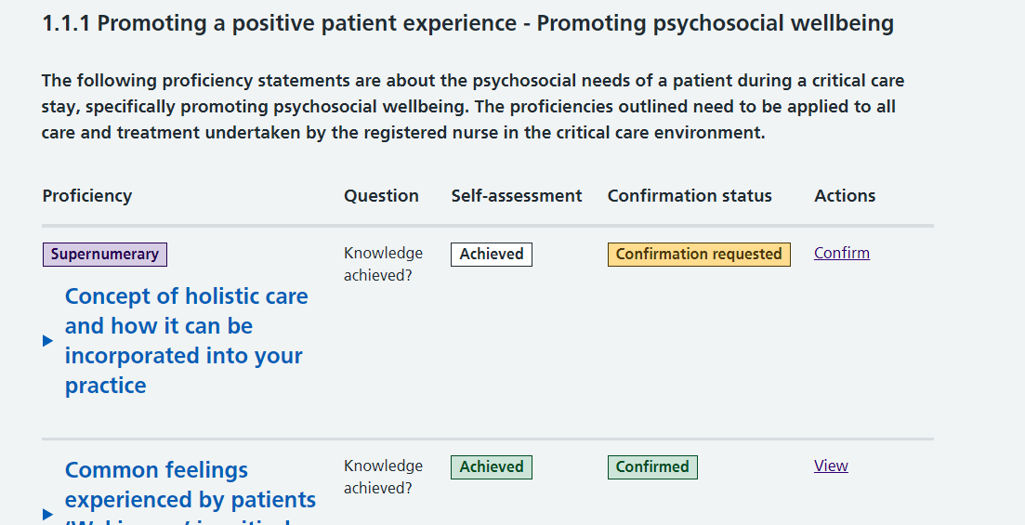
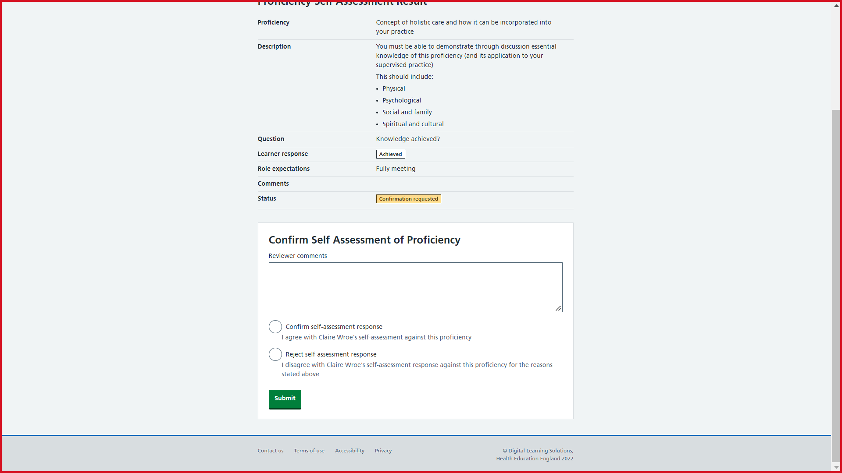

Slide 61
Platform roles & key responsibilities
Role hierarchy
Key responsibilities
Clinical Centre Manager
Trust-level lead & oversight
Select who are Educator/Managers & Administrators
Administrator
Approve self-registration of profiles on platform
Raise support queries or issues
Educator / Manager
Enrol Learner on Step 1 Framework & perform final sign-off
Select who are Assessors
Assessor
Confirm Learners’ self-assessment of individual proficiencies
Learner
Complete self-assessment of proficiencies
Request Assessor confirmation of proficiencies
Note: There can be multiple people in each platform role

Slide 62
National pilot approach
Pilot will run mid-Aug '22 to Mar '23
Up to 60 NHS Trusts over three cohorts (20 Trusts per cohort)
EOI open 4 – 22 July, 5PM
Expression of interest
Jul | Aug | Sept | Oct | Nov | Dec | Jan | Feb | Mar
EOI
(3 weeks)
Selection
(3 weeks)
Cohort 1
Setup (8-10 weeks)
Start using
Cohort 2
Setup (8-10 weeks)
Start using
Cohort 3
Setup (8-10 weeks)

Slide 63
learningnetworks@nhselect.org.uk

Slide 64



The Critical Care Outreach Practitioner Framework:
A National Standardised Credential
Lesley Durham on behalf of:

Slide 65

Introduction
Rationale
Process
Framework Content
Next Steps
Notes:
A collaborative approach

Slide 66
Rationale
The introduction of Critical Care Outreach (CCO) & equivalent services is one of the great successes of responsive patient centred service developments within the NHS – “safety engine of the hospital”
CCO services are delivered in +/- 86% Trusts in England (GIRFT 2021)
CCO is now a career choice
Huge variation in role preparation & training
  Clear need for a National standardised credential and career framework

Slide 67









Process
NOrF, ICS, CC3N collaboration
Engage stakeholders
Recruit CCO experts, health academics
Agree purpose and scope
ToR
Work Streams & Group Leads
Time line (C😞VID – 19!!)
Consultation
Amendments
Endorsements
Publication

Slide 68


Slide 69
CCOP Framework
Purpose:
To facilitate the structured development and career progression of post registration Health Care Professionals (HCPs) working in a CCO or equivalent service and introduce a system of credentialing recognised by CCOPs, hospital managers, clinical and educational commissioners, HEIs, national regulators and the public.
The intention is that the ‘Enhanced Practice Level’ serves as the nationally recognised standard and credential of competence
Aligns with other professional pathways
Enhanced
Advanced
Consultant
Uses justifiable deviance able to function in unpredictable
environment, manages risk defers major decision making
Uses justifiable deviance extensively, unpredictable environment, manages risk
Uses justifiable deviance across whole systems
Systems leadership
Although found in different settings, across professions with a specific body of knowledge
Found in different settings but also has highly developed a specific body of knowledge
High level complex decision making
Complex clinical decision making but defers to others for overall plan
High level complex clinical decision making including complete management of episodes of care. Less door hanging
Masters/Doctoral
Evaluate and create
HEE levels 8&9
Manages a caseload-highly
developed brokering skills, some • Uses brokering skills but not as door hanging frequently as enhanced group
Post reg/post grad qualifications/ CPD occasionally Masters level
Masters level
Evaluate and create
Evaluate and create
HEE levels 6&7
HEE levels 6&7
Leary A (2019) Enhanced practice: A workforce modelling project. Health Education England
Although ‘enhanced’ is a precursor to ‘advanced’ it should be valued as a highly functional level of practice and service delivery & legitimate endpoint of itself
Notes:
In a bit more detail ….The purpose of this Critical Care Outreach Practitioner Framework is to facilitate the structured development and career progression of post registration Health Care Professionals (HCPs) working in a critical care outreach or equivalent service and introduce a system of credentialing recognised by CCOPs, hospital managers, clinical and educational commissioners, HEIs, national regulators and the public. The intention is that the ‘Enhanced Practice Level’ serves as the nationally recognised standard and credential of competence, skills and behaviours required of HCPs providing Critical Care Outreach services, ensuring that CCOPs have a level of competence commensurate with the level of patient care provided.
Enhanced practice as a route to advanced and an end in itself?
Although ‘enhanced’ is a precursor to ‘advanced’ it should very much be valued as a highly functional level of practice and service delivery. There is value in practicing at the ‘enhanced’ level and it is a legitimate endpoint. Some practitioners may prefer the brokering aspect of practice rather than being decision-makers. Therefore, skills practitioners at this level possess should be recognised and valued
Specialist knowledge is articulated across all levels of complexity there was a consensus not to use “specialist” as a level of practice
Leary A 2019
Watch this space!! It may be a useful template for other countries to follow…..

Slide 70
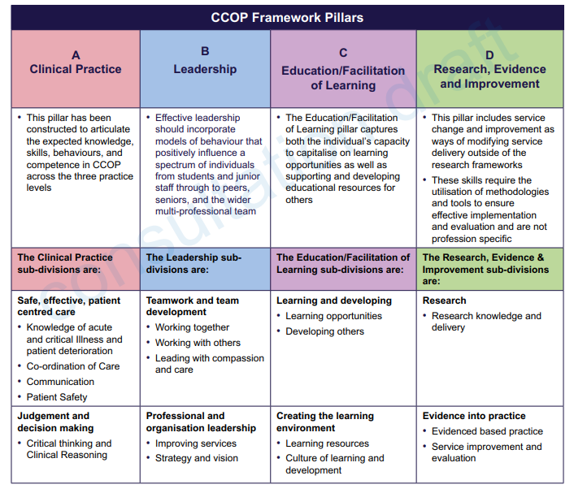

Slide 71
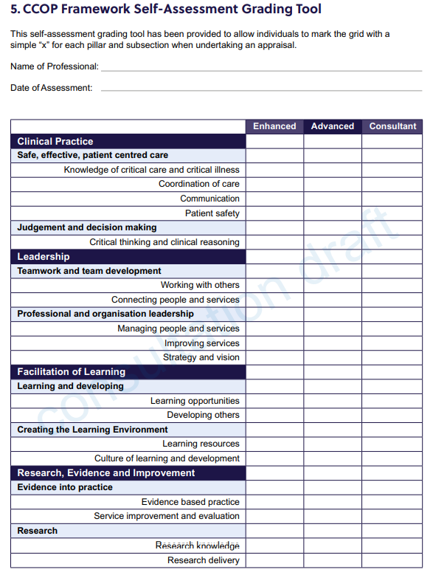

Slide 72
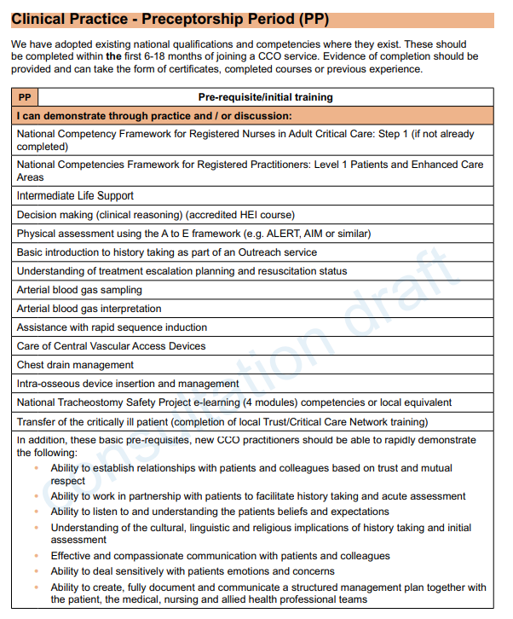

Slide 73
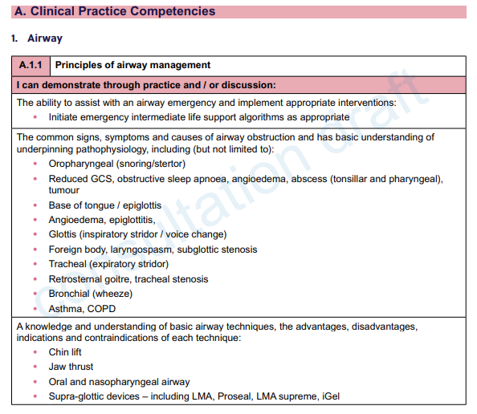
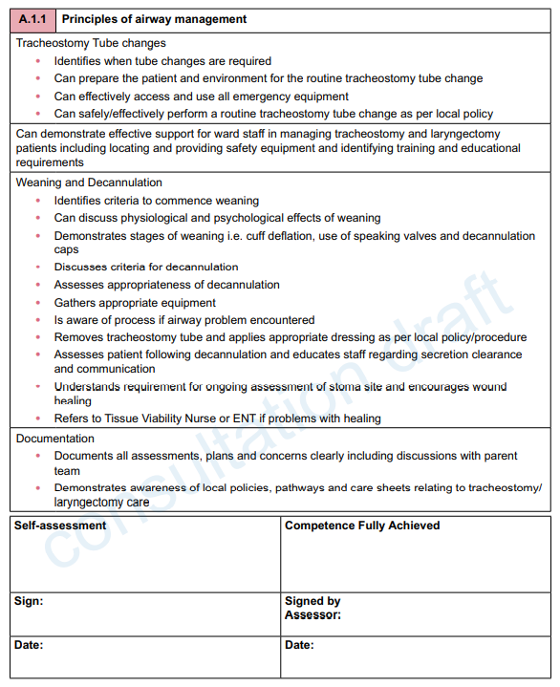
Competencies

Slide 74
Next Steps
Final edit, endorsements, publish
Discussions with HEE
CCOP Framework fits well with the apprenticeship approach
Link with HEI(s) - Mandated qualification – L6 BSc or L7 Post Grad Dip = ECP (CCO)?
Trusts to start including in annual TNA
Start to deliver 2023?
National Register?

Slide 75

My thanks to these amazing people
Sub-Group Leads and Writing Group: Alison Dinning, Asha Abdillahi, Denise Brooks, Karin Gerber, Liz Staveacre, Mandy Coggon
Contributors: Andrea Baldwin, Becky Edwardes, Carol Greenway, Claire Horsfield, Dawn Lacey, Donna Griffiths, Emma Lynch, Emma Richardson, Heather Cooper, Heather Reading, Isabel Gonzalez, Jamie Swales, Jane Dean, Jane Murray, Jennifer McGaughey, Lisa Wood, Lorna Barton, Louise Bradbury, Mandy Odell, Samantha Cook, Sandy Mather, Sarah Hart, Sophie Hadfield, Suman Shrestha, Tracey Moore
Supported by: Andy Ratcliffe, Anne Whiteside, Ian Setchfield, Paul Twose
  The ICS design Team – Asha Abdillahi & colleagues

Slide 76


Thanks for listening
Lesley.durham@nhct.nhs.uk
@leldurham
Stay safe

