Slide 1
Introducing the Nursing Associate Programme In
Critical Care
Fiona Wyton
(UHB Director of Nursing for Critical Care Services)

Slide 2
Why/Why not?
WHY - Our aim was to create a new career pathway for our HCSW’s and also to develop a pathway for our local population to enter nursing through widening participation and entry without experience.
Why Not? – Wouldn’t work in specialist area such as ITU. Can’t use existing RN budget and vacancies. Can’t support the additional educational burden on already fatigued mentors and assessors.

Slide 3
Workforce Constraints
88 Level 3 beds across 3 Hospital Sites – 480 RN’s, 53 HCSW’s
Unavailability Pre-COVID: 25-30%
Retention being the biggest risk to the service
RN Pipelines not sufficient to bridge the RN gaps
Retirements peaking

Slide 4
5 HCSW’s from Critical Care Services commenced their TNA training
Then – Cohort 1- 2017/19
Now – 2022/24 - Cohort 13
13 ITU RNA’s
51 ITU TNA’s (funded 58 wte)
Trajectory -64 RNA’s by 2024

Slide 5
Critical Care Cohort 1 – 2017-2019

Slide 6
UHB Cohort 1 (2017/19)

Slide 7
Trainee deployment (we never say no)

Slide 8
Nursing Attrition Rates
Around 12,500 nurses in adult social care in England left their jobs in 2019-20, representing a turnover rate of 41.3%
Student Nurse attrition rates in England at 25%
UHB TNA attrition rates at 14%

Slide 9
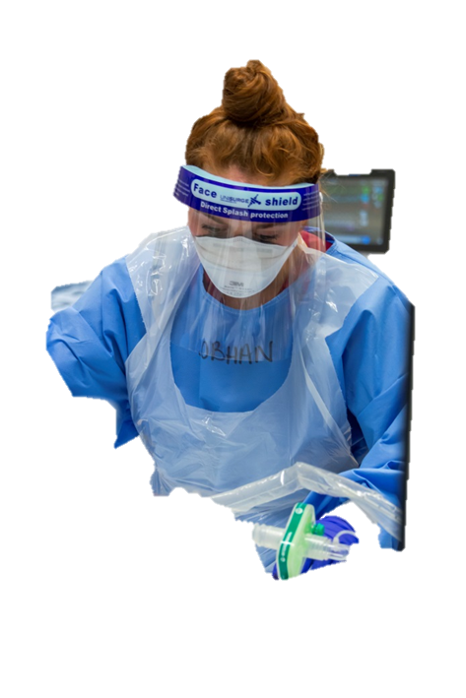
Workforce
National Trajectory for TNA/RNA Roles
Mar-22 | Nurse Associate | Trainee Nurse Associate | Grand Total
UNIVERSITY HOSPITALS BIRMINGHAM NHS FOUNDATION TRUST | 102.71 | 288.63 | 391.34
MANCHESTER UNIVERSITY NHS FOUNDATION TRUST | 154.53 | 181.44 | 335.97
NORTHERN CARE ALLIANCE NHS FOUNDATION TRUST | 98.63 | 110.6 | 209.23
LEEDS TEACHING HOSPITALS NHS TRUST | 54.57 | 149.92 | 204.49

Slide 10
Gaining trust and recognition
Started small
Dedicated TNA Clinical Education Team
“try one, buy one” approach
Didn’t dictate centrally but encouraged growth

Slide 11
Professional
Barriers
Perceived ‘threat’
RNA’s do not fit into specialist clinical areas
Financial expense
Similar to enrolled nurses – nothing new
Lack of understanding of their purpose “cheap nurses”
NMC recognition and registration cause for concern
Nobody had done it before – It was just another pilot

Slide 12
TNA UHB Clinical Education Structure
TNA
Education
1:18 ratio
Lead Nurse
Band 8a
0.8wte
Team Leader
Band 7
2.0wte
TNA Clinical Educators
Band 6
5.0wte
TNA Clinical Educators
Band 5 (RNA)
2.0WTE
TNA Clinical Educators
Band 4
2.0WTE
Admin
Band 3
1.2wte

Slide 13
Maintaining excellence
QIA for RNA’s in practice within registered workforce numbers
Safer staffing allocation when acuity peaks within units
Continuous supervision and understanding of skills mix requirements
Constantly re-evaluating RNA’s roles and responsibilities in practice
in conjunction with NMC registration

Slide 14
Learning
NA program established - focus on CPD opportunities and progressions
Smashing through the glass ceiling – ‘earn and learn’, new to care program
Post registration education and training – accessing specialist courses
Recognising CPD achievements – Assistant Lecturers B5, Clinical Educators B5
HEI’s recognising NA experience - coping well academically with RN top up
3x ITU RNA’s on RN top up program

Slide 15
Wellbeing
ITU Whatsapp TNA/NA professional chat, point of
contact, professional platform for exams, learning
and training advice
20 PNA’s in ITU to clinically supervise TNA’s/RNA’s,
provide restorative practice and confidential advice
Celebrate success, achievements, stay connected,
advertise conferences, training and development
opportunities

Slide 16
Neelam - Critical Care & UHB
2020 – COVID. Stepped up significantly in her clinical role
Trained reservists
Supported colleagues caring for critically ill patients.
Achieved TNA Certificate of Excellence
2021
Nurse critically ill patients
Won a ‘frontline worker of the year award’
Represented the Trust, Critical Care & NA’s on a BBC Documentary
Present to TNA’s about qualifying
Represent UHB at events
Achieved NVQ 2 + 3
despite dyscalculia
2013 – Started as a HCA in Critical Care
2018 - Joined the TNA programme.
Knew she wanted to progress within Critical Care & UHB
Dec 2020 – Became a Registered Nursing Associate in Critical Care
started Nursing her own level 2 & 3 patients
Supporting TNA’s on the unit
2022 -
Commenced
RN Top Up
at UOB

Slide 17
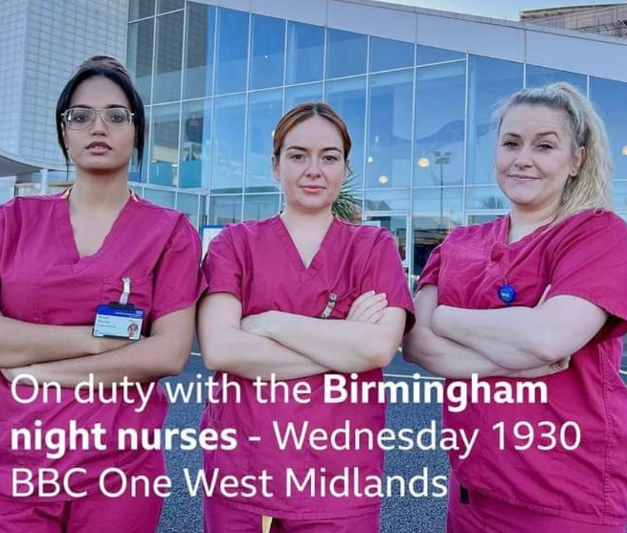

Slide 18
RNA’s in practice on ITU
Can be allocated to level 2 and 3 patients
Can support CVVH
Can do all medicine administrations including IV’s
Can administer all blood products
Can support Level 4 acuity
Can support side room allocations
Can undertake Step 1 competencies
Can undertake further critical care education and training opportunities
Can support safer staffing models
Can be allocated student TNA’s
Can’t work under PGD’s
Can’t be allocated students RN’s, assess and mentor
Can’t supervise registered practitioners

Slide 19
Objectives: A flexible, diverse, work force in critical care Support the pipeline of staff into ITU Skills that move with the patient
HCSW in ICU
Orientation & Induction
Functional skills
HCSW Core competencies
C3NN Specialist competencies
National standards
Mapped to FCC
Mapped to Steps competencies
Shared training programs
TNA/RNA/RN training pathway

